Slide 1
Watching Me?

Slide 2
Do you ever get that feeling that you’re being stared at?
Then, when you turn around you notice somebody looking right at you?

Slide 3
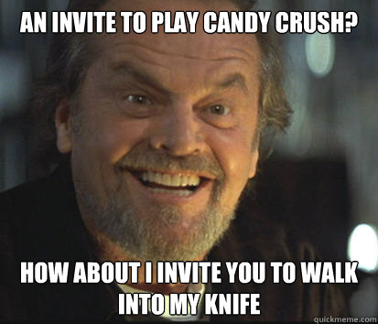
Whoops! Wrong knife story!!!!!

Slide 4
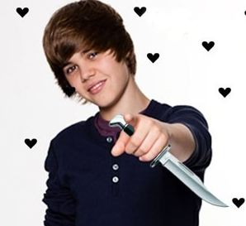
Scary, but not very Belibable

Slide 5
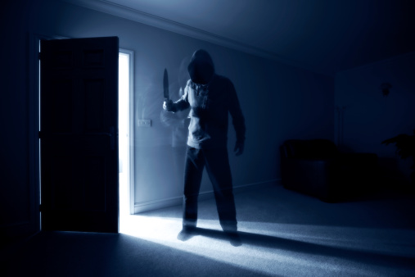
Here is the correct story
Take out a sheet of paper

Slide 6
Claim:
Can You Tell If Someone Is Staring At You?

Slide 7
My prediction (hypothesis):
Write as an If…then statement
please
Write as an If..then….because
statement if you are awesome

Slide 8
We need a fair experiment. Here are some things we might need
A randomly generated number which told the audience who to stare at.
Students that cannot see, hear?
Things need to be constant to be fair
How can we scientists tell if they feel it?
We need to collect data both HITS and MISSES
Need to do it more than once to minimize chance

Slide 9
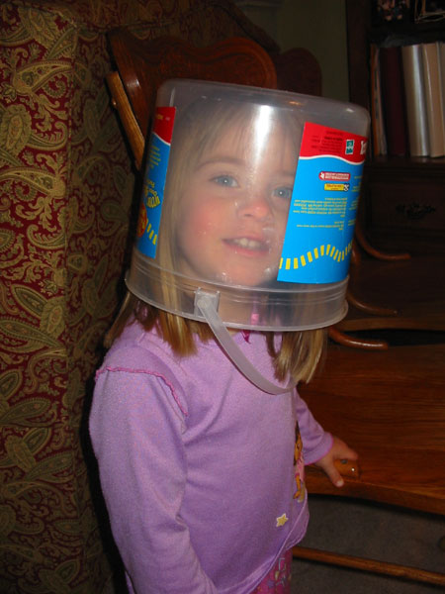
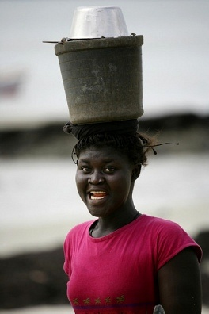
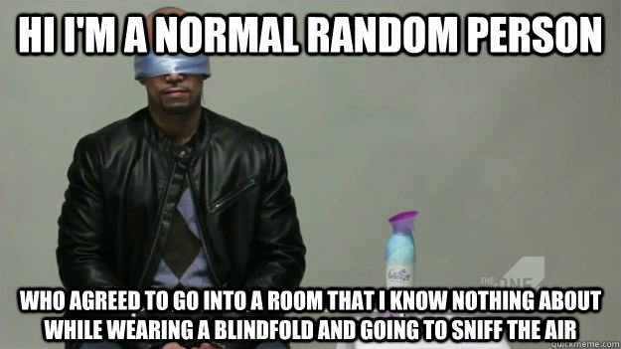
Probably not.

Slide 10
Constants:
Write down some ideas for the experiment that might need to be kept constant to keep this a fair and valid experiment

Slide 11
Much better experiment set up
1
2
3

Slide 12
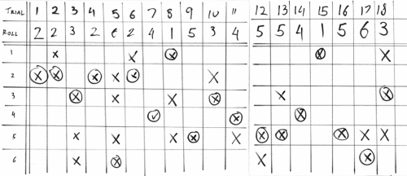
Data Table Example

