Slide 1
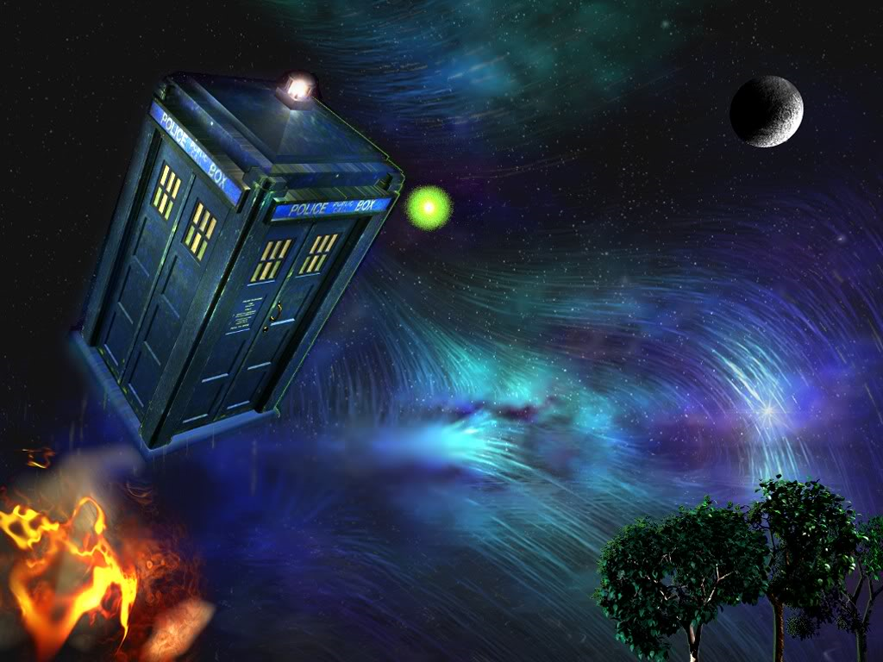
Puzzles and Paradoxes of Time Travel

Slide 2
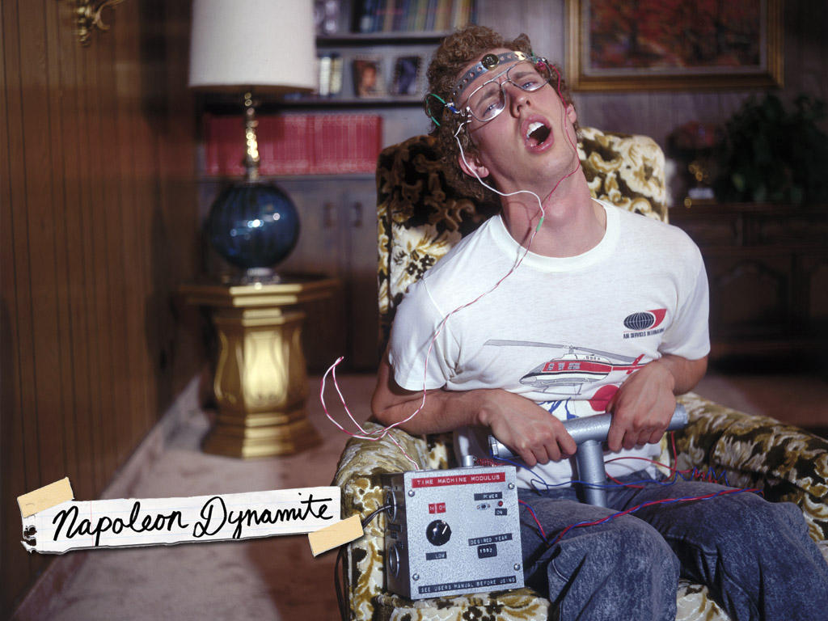
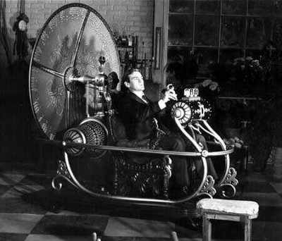
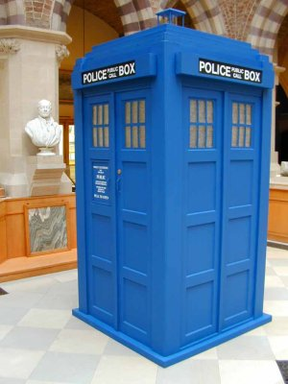
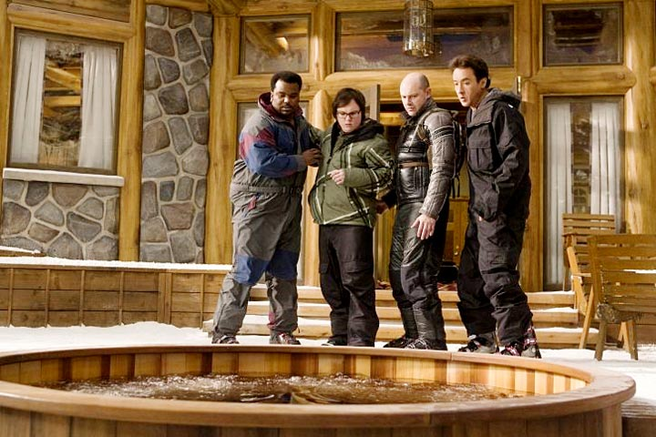

Slide 3
Backwards Time Travel
Going forward in time is (relatively) easy
Going back is much harder
Einstein’s theory of general relativity seems to allow it
It depends just how much space-time can curve

Slide 4
Being Specific about Time Travel
Actually going to the future or past
Not just some replica of it
It’s all relative
For me to time travel, there would need to be a difference between the speed time passes for me and the speed time passes for someone or everyone else

Slide 5
What is Forward Time Travel?
Forward time travel: my time goes slower than yours (like aging slower than everyone else)
My time goes slower than yours as my speed increases (relative to yours) and/or if I am closer to mass than you (and if that mass increases)

Slide 6
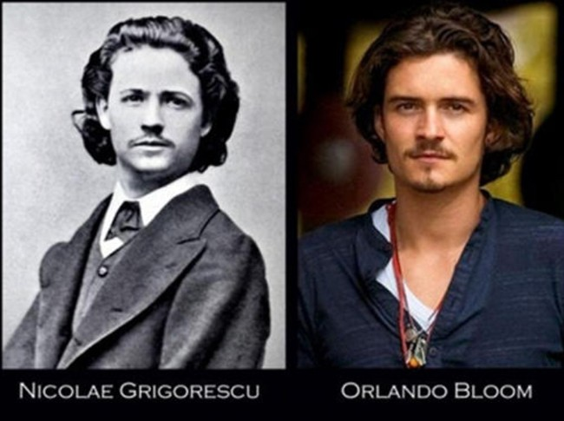
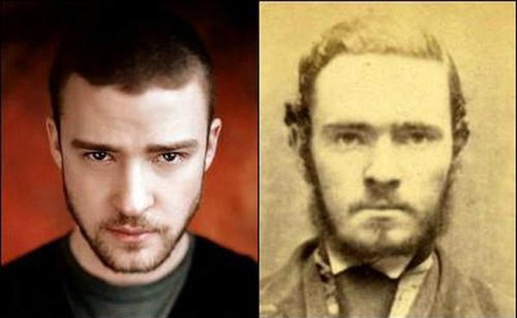
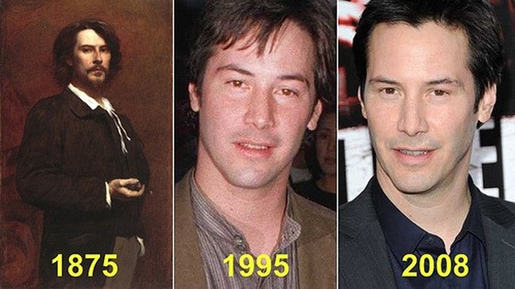

Slide 7
About Relativity
As an object approaches the speed of light, time slows down.
(Moving clocks are slow)
(Moving rulers are short)

Slide 8
The Lorentz factor
We use this equation

Slide 9
A trip from Earth to Planet Hollywood
Homer stays on Earth.
Loner travels 10 light-years at 80% of the speed of light. (speed of light = c)
Beta (β) is the velocity of the object compared to the speed of light. (β = 4/5c = 0.8c)
Gamma (γ) is the effect of traveling at speeds close to light speed (c) has on time (t) or distance (x).

Slide 10
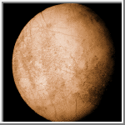
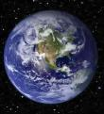
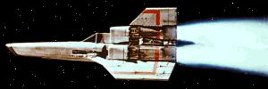
Homer
Planet Hollywood
Loner
Earth

Slide 11
Effect of Time on Spaceship
Velocity (v) is v = 4/5c = 0.8c therefore…
β = 4/5 = 0.8
1
γ =
(β² = 0.8² = 0.64)
1 - β²
1 - β² = 1 - 0.64 = 0.36 and the √ of 0.36 is 0.6 !!
γ = 1 ÷ 0.6 = 1²/³ = 5/3

Slide 12
As Viewed From Earth
Without Relativity…..
x = vt or t = x/v
x is light years traveled
v is velocity.
t is time.
t = 10/0.8c = 12.5 years each way.
There and back makes the trip
12.5 x 2 or 25 years!!

Slide 13
As Viewed From Earth
With Relativity
Homer sees Loner’s clock is running slow by…
γ = 5/3 !!
Therefore Loner’s clock reads 25 years ÷ γ
25 ÷ 5/3 = 15 years!!

Slide 14
Physical Results of Trip
Homer on Earth ages 25 years!!
Loner, traveling at 80% the speed of light ages 15 years!!

Slide 15
Making a Worm Hole
Black holes warp space-time a lot because of their intense mass
Flying a spaceship through one would be pretty risky
And, who knows where it would take you even if you could make it through

Slide 16
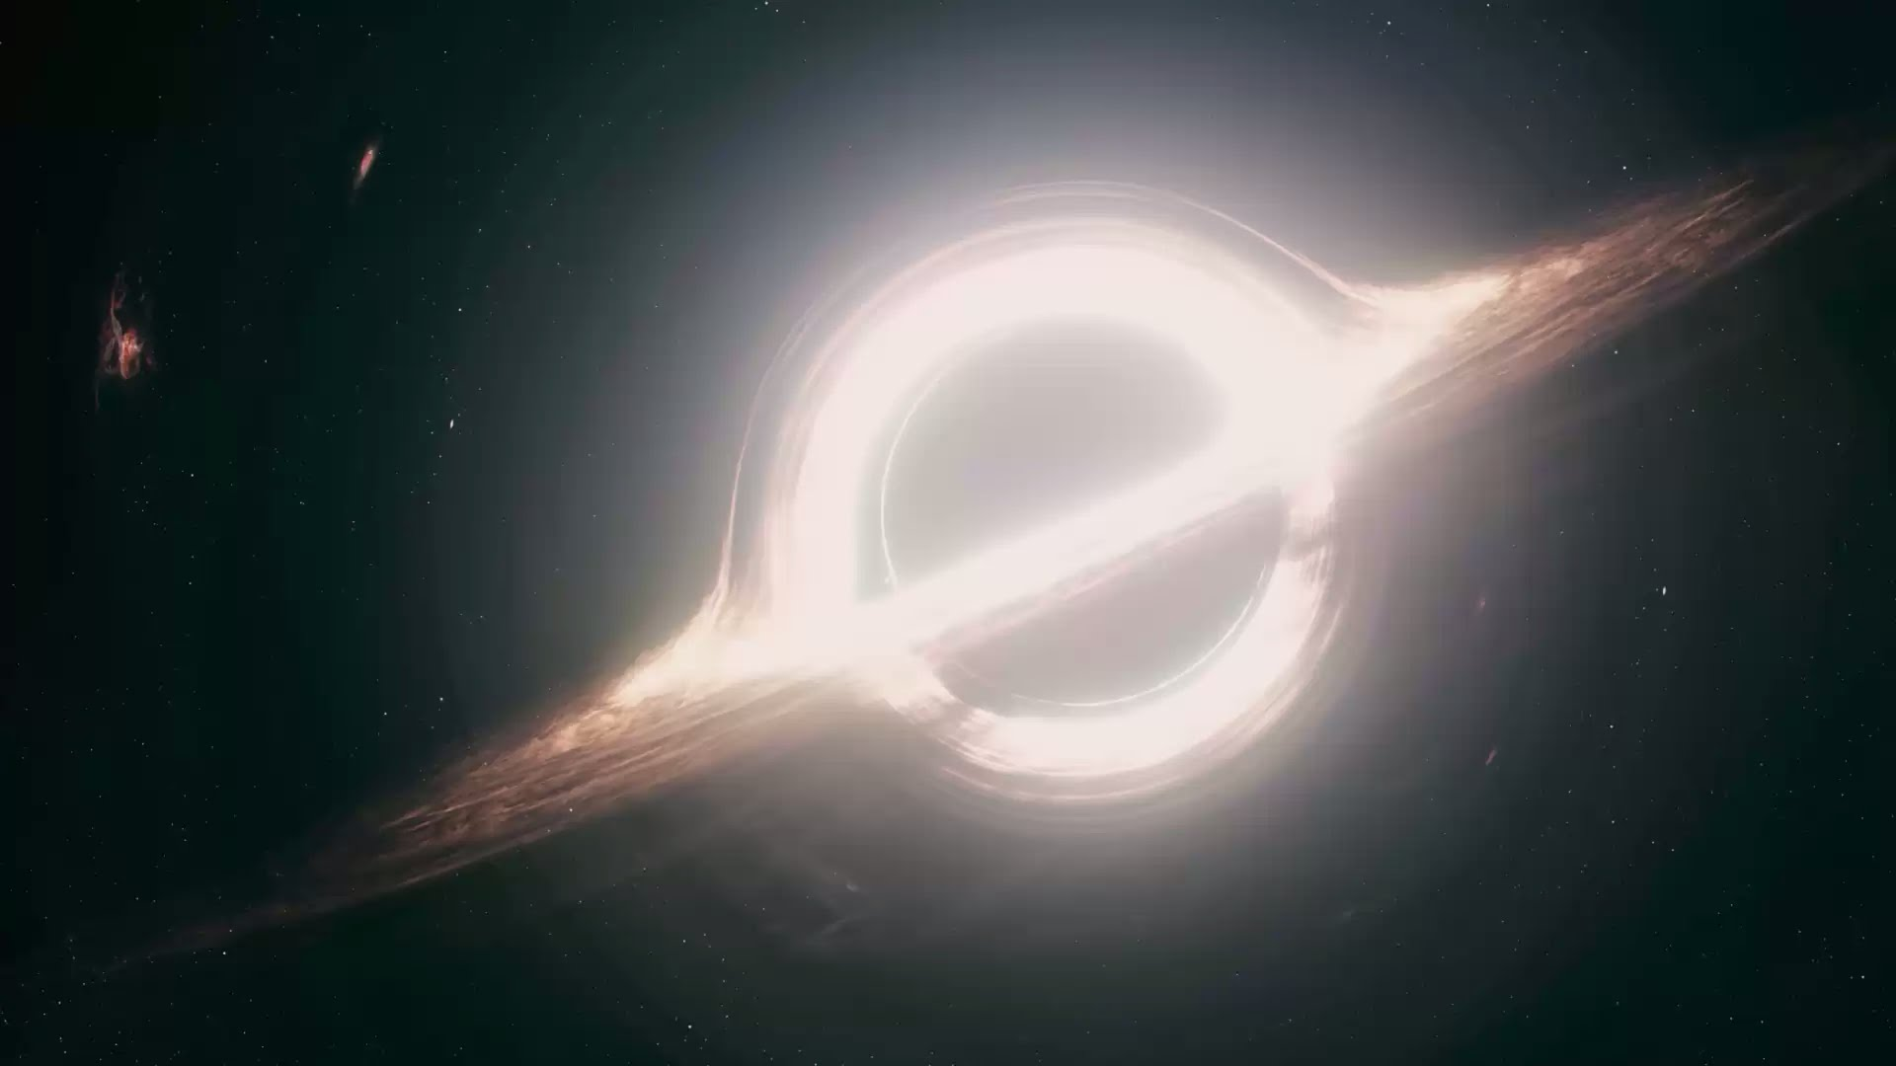

Slide 18
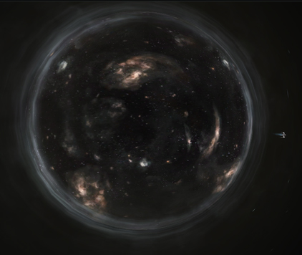

Slide 19
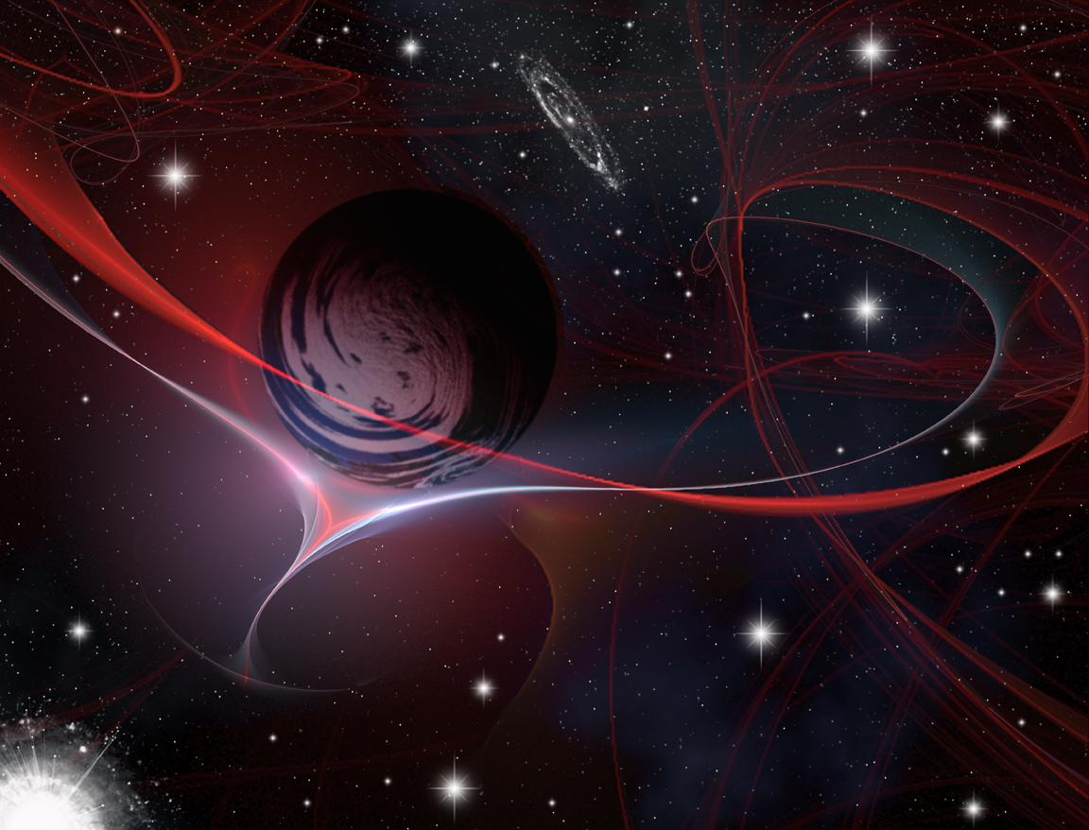
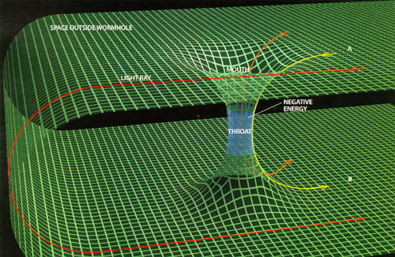
A Closed Time-Like Loop

Slide 20
This is not a Physics Course
Don’t worry if that’s confusing
the exam question will be based on the logical paradoxes of time travel
Any questions on what time travel is?

Slide 21
Take-Home Lessons
Time is not like what it seems
If you have an assignment to do, you should do it on the top floor of the library instead of the bottom… because you’ll work faster! (As long as you can get there and back quickly)
To stay young-looking compared to your friends, make sure you take more long-haul flights than them!

Slide 22
Time Travel is Possible!?!?!
This might be a hoax, but time travel really is possible
In fact, many of us have already done it

Slide 23
What is Time Travel Again?
It’s all relative
For me to time travel, there would need to be a difference between the speed time passes for me and the speed time passes for someone or everyone else

Slide 24
What is Forward Time Travel?
Forward time travel: my time goes slower than yours (like aging slower than everyone else)
My time goes slower than yours as my speed increases (relative to yours) and/or if I am closer to mass than you (and if that mass increases)

Slide 25
This is not a Physics Course
Don’t worry if that’s confusing
the exam question will be based on the logical paradoxes of time travel
Any questions on what time travel is?

Slide 26
Time Travel
The (Easy) Paradoxes of Time Travel

Slide 27
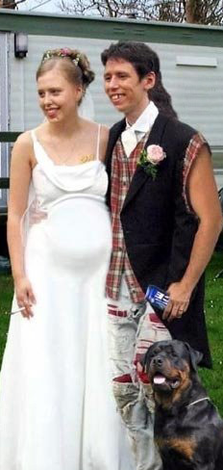
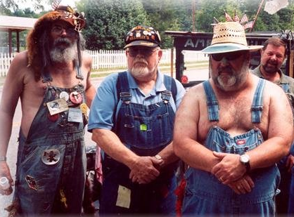
Fathering Yourself is Impossible
How is it possible for someone to be their own father??

Slide 28
Fathering Yourself is Backwards Causation
To father yourself, you would have to procreate with your mother, but that probably requires a few shots… and backwards causation – doesn’t it?
Surely it would be causing a change in the past, which is impossible!
The past has already happened, so how can we change it?

Slide 29
Backwards Causation
We normally think of effects as following their cause
Study (usually) causes the effect of a good grade
The history of Europe has caused the borders between nations to be recognised as they are today
But, if you father yourself then the effect of that procreation is also the cause!
Like getting a good grade causing you to have already studied!

Slide 30
The In Two Places at Once Paradox
No one person can wholly be in two places at once
Wholly is important here
If you believe this, (which you should) then doesn’t that mean time travel is impossible?
(because it would allow you to go and wish yourself many happy returns at your last birthday party)

Slide 31
Visiting Myself
My last birthday party
Me existing through space-time

Slide 32
Take-Home Lessons
If you time travel into the past, avoid your parents at all costs.
Marty McFly learned this lesson the hard way.

Slide 33
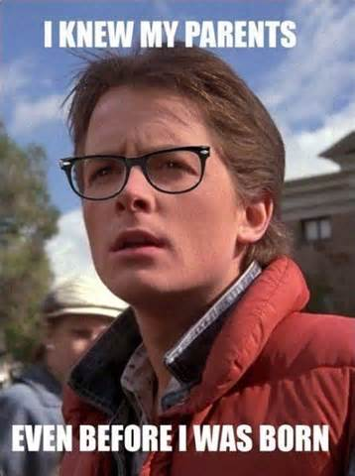
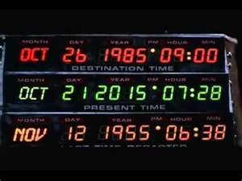
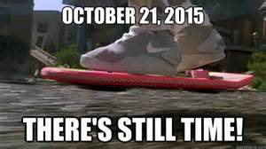

Slide 34
Next Time (+ Exam Tip!!!!)
Get ready to attempt to solve the logical paradoxes of time travel, including the Grandfather Paradox – which will be very useful to know for the exam

Slide 35
Time Travel
The (Hard) Paradoxes of Time Travel

Slide 36
The Paradox of Changing the Past
If you could go back in time, you could do more study for the test and get a better grade
But, you already have a grade! You can’t change it – its part of history now!
P1) If time travel is possible, then you could change the past
P2) It is never possible to change the past
C) Therefore, time travel must not be possible

Slide 37
Replying to the Paradox of Changing the Past
Denying P1: Time travel is possible, but it does not and cannot change the past
When you time travel, you create a new alternate universe
So you can change things, but not things from the past in our universe
When you time travel, you can affect the past because you already did
You don’t change history… you had already affected it!
An accurate history book would already have a record of you being there!

Slide 38
Telling Myself to Study
When I should have been studying
Me existing through space-time

Slide 39
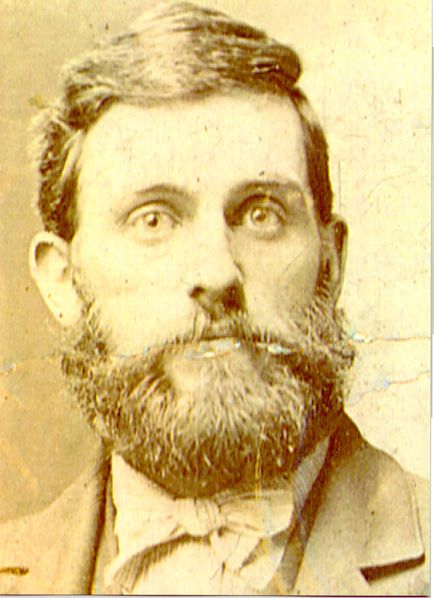
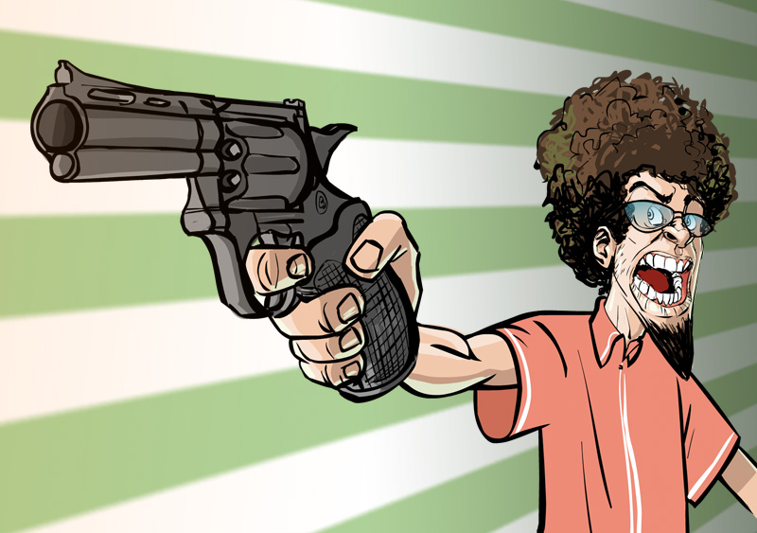
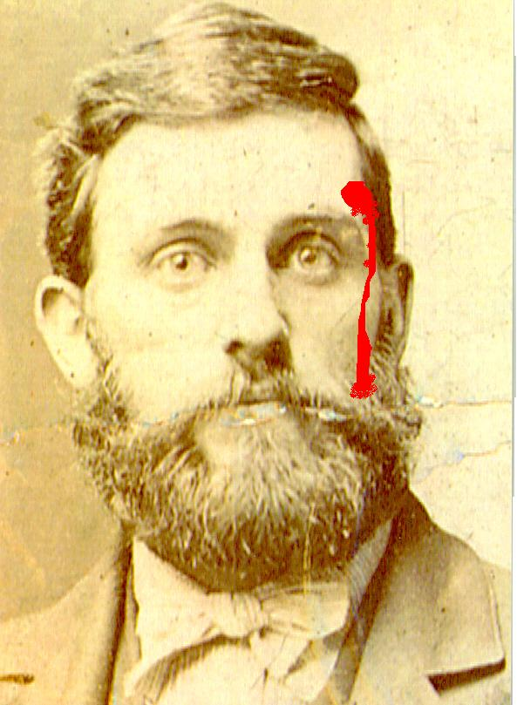
The Grandfather Paradox
If you could go back in time, you could kill your grandfather before he could produce any offspring
But, if you did that, then there would have been no you to make a time machine and go and kill him!
Which means that you can’t have killed him…

Slide 40
The Grandfather Paradox
April, 2000. Carl enters time machine.
June, 1980. Son Carl is born.
But, if Carlos is
killed by Carl,
Carl is never born!
Carl cannot kill
Carlos if Carl is
never born … ??
Carl travels back in time to October, 1940.
September, 1948. Father Carlito is born.
January, 1948. Father Carlito is conceived.
October, 1940. Carl murders Carlos!!
January, 1919. Grandfather Carlos is born.

Slide 41
The Grandfather Paradox (Cont.)
P1) If time travel is possible, then you could kill your grandfather (before he had kids)
P2) It is impossible for you to have existed if you succeed in killing your grandfather (before he had kids)
C) Therefore, time travel must not be possible

Slide 42
Replying to the Grandfather Paradox 1
Denying P1: Time travel is possible, but you do not and cannot kill your grandfather
When you time travel, you create a new alternate universe
So you can kill some old guy… but it’s not your grandfather (not from your past)
But does time travelling to an alternate universe really count?
Is it time travel or inter-universal travel?
For time travel to be meaningful does it have to be to our own past?

Slide 43
Replying to the Grandfather Paradox 2
Denying P1: Time travel is possible, but you do not and cannot kill your grandfather
When you time travel, you can affect the past, but only because you already did
E.g. If you had already been there and killed your grandfather… then you would never have existed

Slide 44
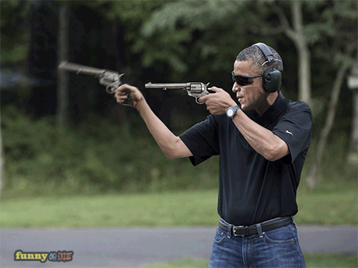
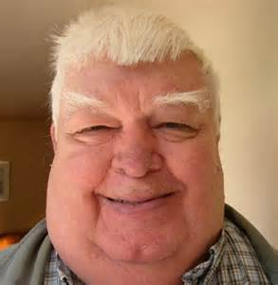
Replying to the Grandfather Paradox 3
Denying P1: Time travel is possible, but you do not and cannot kill your grandfather
When you time travel, you can attempt to kill your grandfather, but you will never succeed
Missed

Slide 45
Replying to the Grandfather Paradox 3
It doesn’t have to be magic or Time Guardians that prevents the impossible from happening
Because it’s impossible to kill your grandfather… it’s necessarily true that you didn’t kill him
(however that came about)

Slide 46
OK Fine, but where are the Time Travelers, then?
P1) If time travel ever becomes possible in the future, then time travelers would most likely have visited our past already
P2) But there is no evidence of time travelers in our past
P3) It is very unlikely that the time travelers could have left no evidence
C) Therefore, it’s very unlikely that time travel ever becomes possible

Slide 47
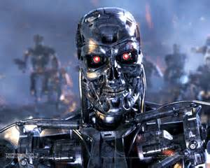
Replying to the No Evidence of Time Travelers Problem 1
Accept the argument
It’s true that there are no time travelers… but only because:
Global warming, or
Nuclear war, or
Super-viruses, or
The robotic uprising …
… killed off all of the humans before we got around to making time machines!
…hated the future and went back to destroy the time machine

Slide 48
Take-Home Lessons
Time travel in movies is usually illogical, but
Time travel is theoretically and logically possible in real life
But if you have homicidal intentions towards your ancestors…
then make sure that you look out for banana skins

Slide 49
The Time Machine Paradox
November, 3040. She says, “I want to go
back.” Returns to the time machine.
She explores the future. Discovers
a depressing world of mutants and non
smiling Kayne clones.
October, 3040. Willow arrives in the future.
Willow travels back in
time to August, 2040.
Willow travels to the future.
September, 2040. Willow enters the
time machine.
August, 2040. Willow destroys
(both!) time machines!
Willow hesitates. She waits a few months
Before using the time machine.
If the time machine
is destroyed, Willow cannot
travel to the future
nor return to destroy
the time machine …??
July, 2040. The time machine is now finished.
Willow takes 10 years to build a time machine.
July, 2030. Willow Donnelly discovers the
principle of the time machine.

Slide 50
The Breakfast Creation Paradox
9:00:01 am. Return after serving breakfast.
Clean dishes.
9:00 am. Step into time
machine with breakfast.
Travel to
the future
Prepare breakfast.
What causes the
appearance of
breakfast? Thoughts
and intentions
alone?
Travel to the past
with breakfast
8:30 am. Get out of bed.
7:46 am. Serve yourself breakfast!
7:45 am. Decide: “Later I’ll prepare
breakfast, travel back to the past, then
set breakfast before myself one minute
from now.”
Lie in bed thinking how nice
it would be to have breakfast.
From: Cosmic Wormholes
by Paul Halpern
7:30 am. Wake up.

Slide 51
The Statue Creation Paradox
May 3, 2092. At night Rocky loads the statue
into the time machine. Then he leaves for
the past.
Question:
When was the
statue made??
Rocky discovers a statue of himself erected
to honor the first time traveler.
Date on base: July 20, 2050
Rocky takes
the statue back
to provide
evidence of
his time journey.
May 1, 2092. Rocky arrives in the future.
?
August 10, 2080. Rocky dies.
Rocky
travels
to the
future.
July 20, 2050. The statue of Rocky Bronze
is erected to honor the first time traveler.
June 2, 2050. Rocky returns. He rolls out
the statue, and is given a hero’s welcome.
From: Find The Sculptor
by Sam mines
April, 2050. Our hero, Rocky Bronze,
enters the time machine.

Slide 52
The Knowledge Creation Paradox
February 16, 3021. Ned gets in the time
machine with the copy. He leaves for the past.
Where did the
knowledge
come from???
Ned
copies
the
paper.
February 15, 3021. Ned finds famous paper on
halting aging. The paper, titled: “Immortality”,
was published in the journal Nature in
September, 2015. The author is Ann Young.
Ned
returns
to the
past.
February 10, 3021. Ned arrives in the future.
?
September, 2015. Ann publishes the paper
“Immortality” in the journal Nature.
Ned
travels
to the
future.
Ned shows Ann the paper. She learns the
theory.
April 6, 2014. Ned finds senior RMWC
biology major, Ann Young.
March 11, 2014. Ned returns with a copy
of the paper.
Idea from: About Time
by Paul Davies
March 10, 2014. Time traveler, Ned Copy,
leaves for the future.

Slide 53
Zoltan Tries to Shoot Himself
Why doesn’t Zoltan just shoot
himself now? Well, … never mind!
February, 2010. Zoltan is now so depressed
that he wishes he never survived the shooting.
He decides to travel back in a time machine
and shoot himself.
Zoltan travels
back in time
with a gun and
an aching elbow.
January, 2009. Zoltan becomes depressed
about his clumsiness. He grows a beard.
A policeman
shoots and kills
the bearded
Zoltan.
December, 2005. Zoltan’s elbow wound
has caused severe damage and destroyed
much of his natural coordination.
October, 2005. A scruffy bearded stranger
fires several shots at Zoltan. Zoltan is hit
in the right elbow.
Zoltan tries to kill his
previous self, but his
defective elbow prevents
accurate aiming!
September, 2005. Young Zoltan is a
happy, carefree, right-handed rascal.

Slide 54
Anne Goes to Work
Idea from: Cosmic Wormholes
by Paul Halpern
8:31:08. Anne continues walking
on to work along the path!
8:31:05. Anne pushes Ann into the time
machine on the right side of the path.
The time machine has been preset to send
a time traveler back 5 seconds.
Startled Ann
travels back
in time. She
quickly
changes her
name to Anne.
Anne walks
along behind
Ann fuming!
Ann walks along towards the time
machine unconcerned.
8:30:57. Ann passes a stone marker by
the side of the path. The time machine door
is just ahead on her right.
8:31:00. Anne suddenly emerges from
a time machine. She is enraged to
find an identical replica of herself
walking along the path just in front
of her! This occurs just a few steps
beyond the stone marker.
8:30:00 AM. Ann is walking to work. She
approaches the open door of a time machine
on the side of the path ahead.

Slide 55
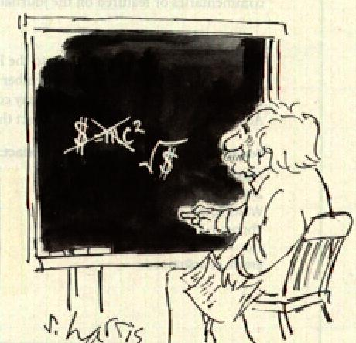
Albert Einstein, in his later years, was unable to figure out why, if he was so smart and so famous, he wasn’t rich.

Slide 56
How to Get Rich With a Time Machine and Get Four Times More Out of Life
Scrooge #1
travels
back in
time.
Becomes
Scrooge #2.
Jan. 4, 2009. Scrooge #4 closes the account. He now has the original
$1,000 plus the interest earned on $4,000 for one year.
January 3, 2009. Scrooge #1 gets into a
time machine with $1,000.
Scrooge #2
travels back
in time.
Becomes
Scrooge #3.
10:00 am, January 2, 2009. Scrooge #1
withdraws $1,000 from bank account #13.
He leaves the interest in the account.
9:30 am, Jan. 2, 2009. Scrooge #2 withdraws $1,000
from account #13.
9:00 am, Jan. 2, 2009. Scrooge #3 withdraws $1,000
from account #13.
Scrooge #3
travels back
in time.
Becomes
Scrooge #4.
Four simultaneous versions of Scrooge
exist. Each has deposited $1,000 in
account #13. Interest accumulates on $4,000.
The Scrooges can eat 4 bowls of chocolate
chip ice cream at once!
1:00 pm,
Jan. 2, 2008.
Scrooge #4
deposits $1,000
in account #13.
10:00 am, January 2, 2008. Scrooge #1
deposits $1,000 into bank account #13.
12:00 am, Jan. 2, 2008.
Scrooge #3 deposits
$1,000 in account #13.
11:00 am, Jan. 2, 2008.
Scrooge #2 deposits
$1,000 in account #13.
December 27, 2007. Scrooge #1 has $1,000

Slide 57
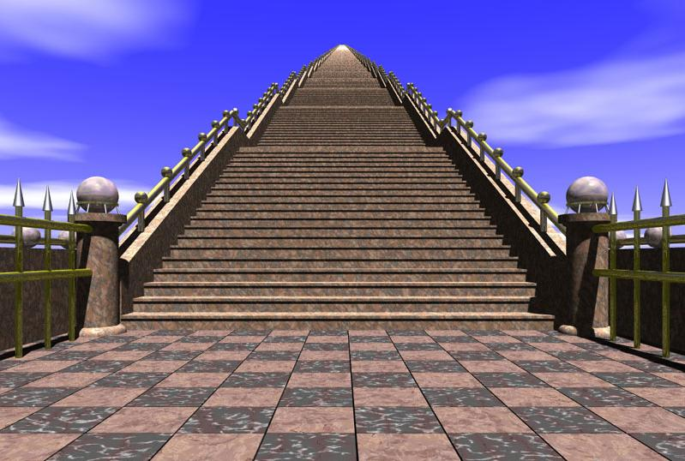
Thinking About Time Machines

Slide 58
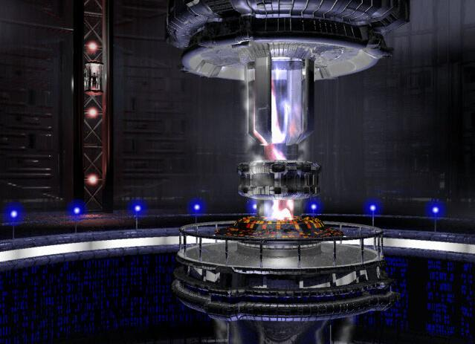
What Do They
Look Like?

Slide 59
How does time progress within the time machine when the machine is traveling through time?
Question: How much time does a time traveler spend in
each epoch as he travels through time?
NOV 10 08:31:05
:
:
The time traveler’s own digital
clock advances normally.
The clock showing progression of time
outside the time machine exhibits
rapidly changing digits. Often, they
change so rapidly they are blurred!

Slide 60
What happens at the boundary of the time machine?
Magnified wall
of time machine
Time
“flies”
Normal Time
Some
atoms
in the
wall of
the time
machine
where
time is
normal.
Some atoms
outside the
time machine
where time
“flies” forward
or backward
Magnified wall
of time machine
Normal Time?
Or
Time continuously
changing rate
within the wall?
Do these atoms interact?
They’re right next to
each other?
Time
“flies”
Normal Time

Slide 61
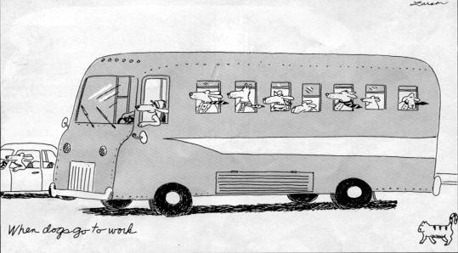
If you roll down the window and stick your head out of the time machine, what happens?

Slide 62
After the time machine leaves the present what is left in its place?
One nanosecond after the
time machine begins traveling:
One nanosecond before
the time machine begins
to travel:
Perfect vacuum?
The material constituents of the
time machine occupy space and
prevent surrounding matter from
occupying the same space.
The material constituents of the time
machine are no longer present. Is a
momentary perfect vacuum left behind?
Does a sudden implosion result?

Slide 63
How to create a perfect vacuum with a time machine:
When the time
machine leaves
a perfect vacuum
is left within the
container.
A time machine
tightly enclosed in
some larger container.

Slide 64
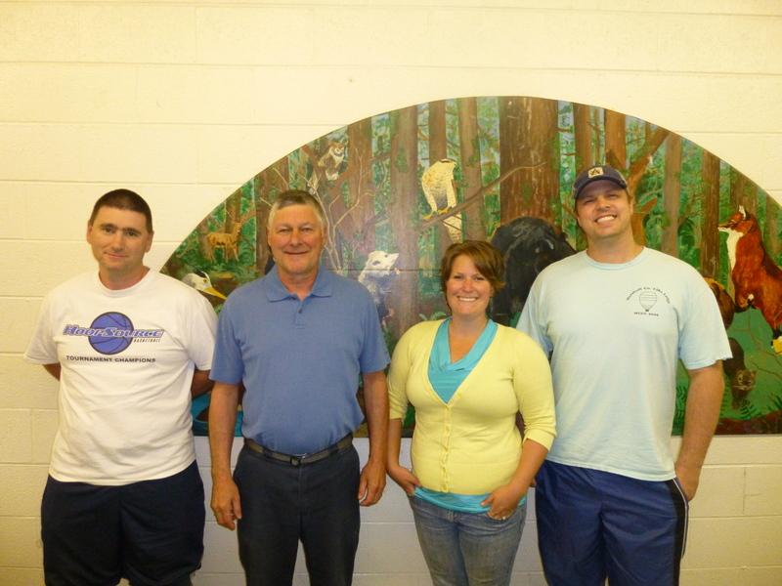
When the time machine arrives at its temporal destination, does it displace matter already there?

Slide 65
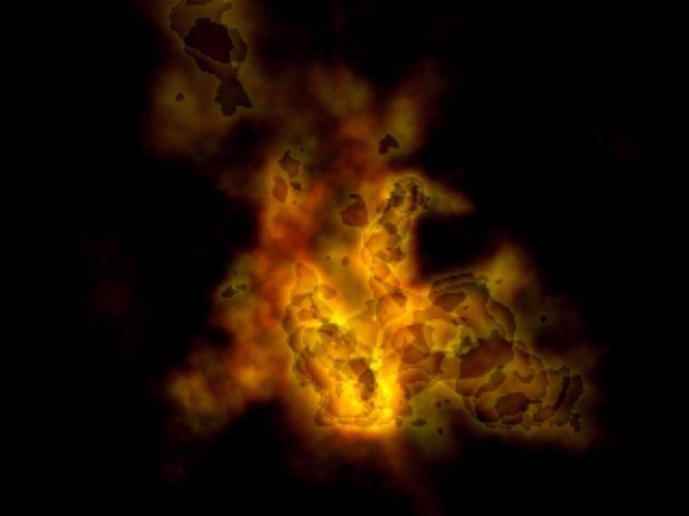
What if the time machine arrives in the midst of a nuclear explosion?

Slide 66
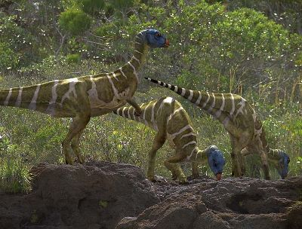
What if the time machine arrives in the middle of a dinosaur’s gut?

Slide 67
What happens if one time machine is nested inside another?
If the forward and backward
time travel rates of the two time
machines are equal, will time
machine #2 remain in the “present”
surrounded by a region (green)
which moves toward the future?
Time machine #1 travels
forward in time.
Time machine #2
travels back in time.

Slide 68
Is there a “velocity addition law” for time travel rates?
Does the rate of forward time travel for
time machine #2 (relative to the “present”)
equal R1 + R2 ?
Time machine #1 travels
forward in time at rate R1.
Time machine #2
travels forward in
time at rate R2.
Is there an upper limit on the rate of
time travel as there is for travel
through space?

Slide 69
What do we mean by a time travel rate anyway?
Rate of travel through space ~ Velocity ~ in meters/second
Rate of travel through time ~ ???????? ~ in seconds/second
This measures how many seconds of time outside the time machine
elapse during one second of time within the time machine. But a
“second per second” has no units!!??
Understanding by analogy?
The slope of a hill ~ Gradient ~ is measured in meters/meter
The fractional change of length ~ Strain ~ is measured in meters/meter
But ...
The idea of a time gradient would require more than one time dimension!!!
The idea of a time strain requires time to expand or compress???

Slide 70
What happens when time machines collide?
Is there some intermediate time
travel rate in this collision region?
Time machine #1 travels
forward in time.
Do the left and right halves of
the time travelers travel at
different rates??
Are they smeared out in time?
?
?
?
?
?
Time machine #2 travels
back in time.

Slide 71
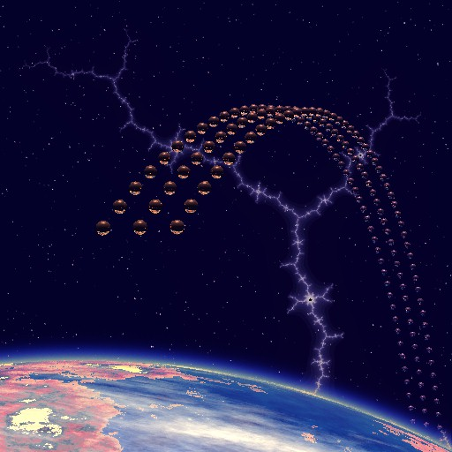
Does spatial location change during the journey through time?

