Slide 1
THE PROCESS OF SCIENCE

Slide 3
1: We did an experiment and this dot represents evidence
Evidence

Slide 4
2: We perform more experiments and they give us more evidence.

Slide 5
2: We connect the lines of evidence and develop a scientific theory.

Slide 6
4: But there can be more than one theory to explain the evidence.
come up with 3 more of your own

Slide 8
5: We gather more evidence.

Slide 9
6: We can eliminate apparently incorrect theories

Slide 10
All theories make assumptions

Slide 11
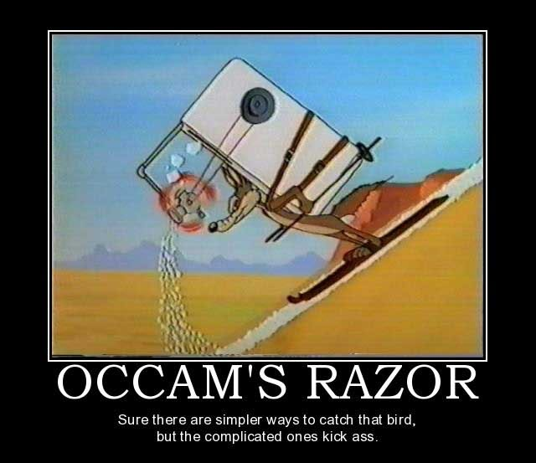

Slide 12
7: Those that make the fewest assumptions usually are correct. (Simplest ones)

Slide 13
8: We tend to focus on the theory with the fewest assumptions

Slide 14
9: This allows us to get as accurate a model as we can.

Slide 15
The Truth
Our Theory

