Slide 1
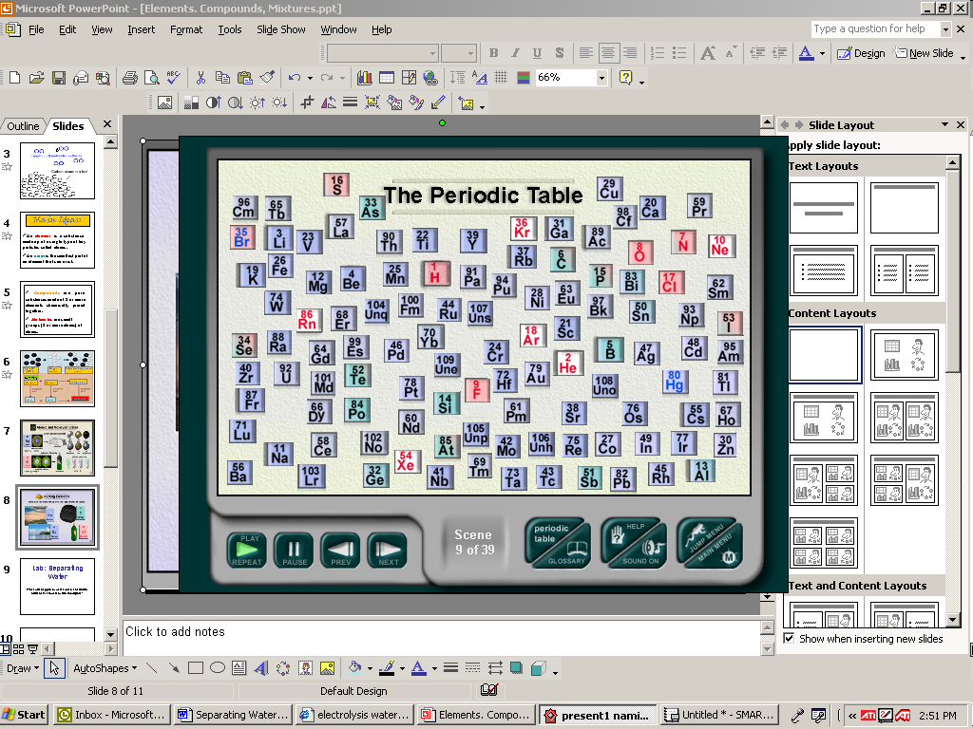
Demystifying the Periodic Table
Notes:
1

Slide 2
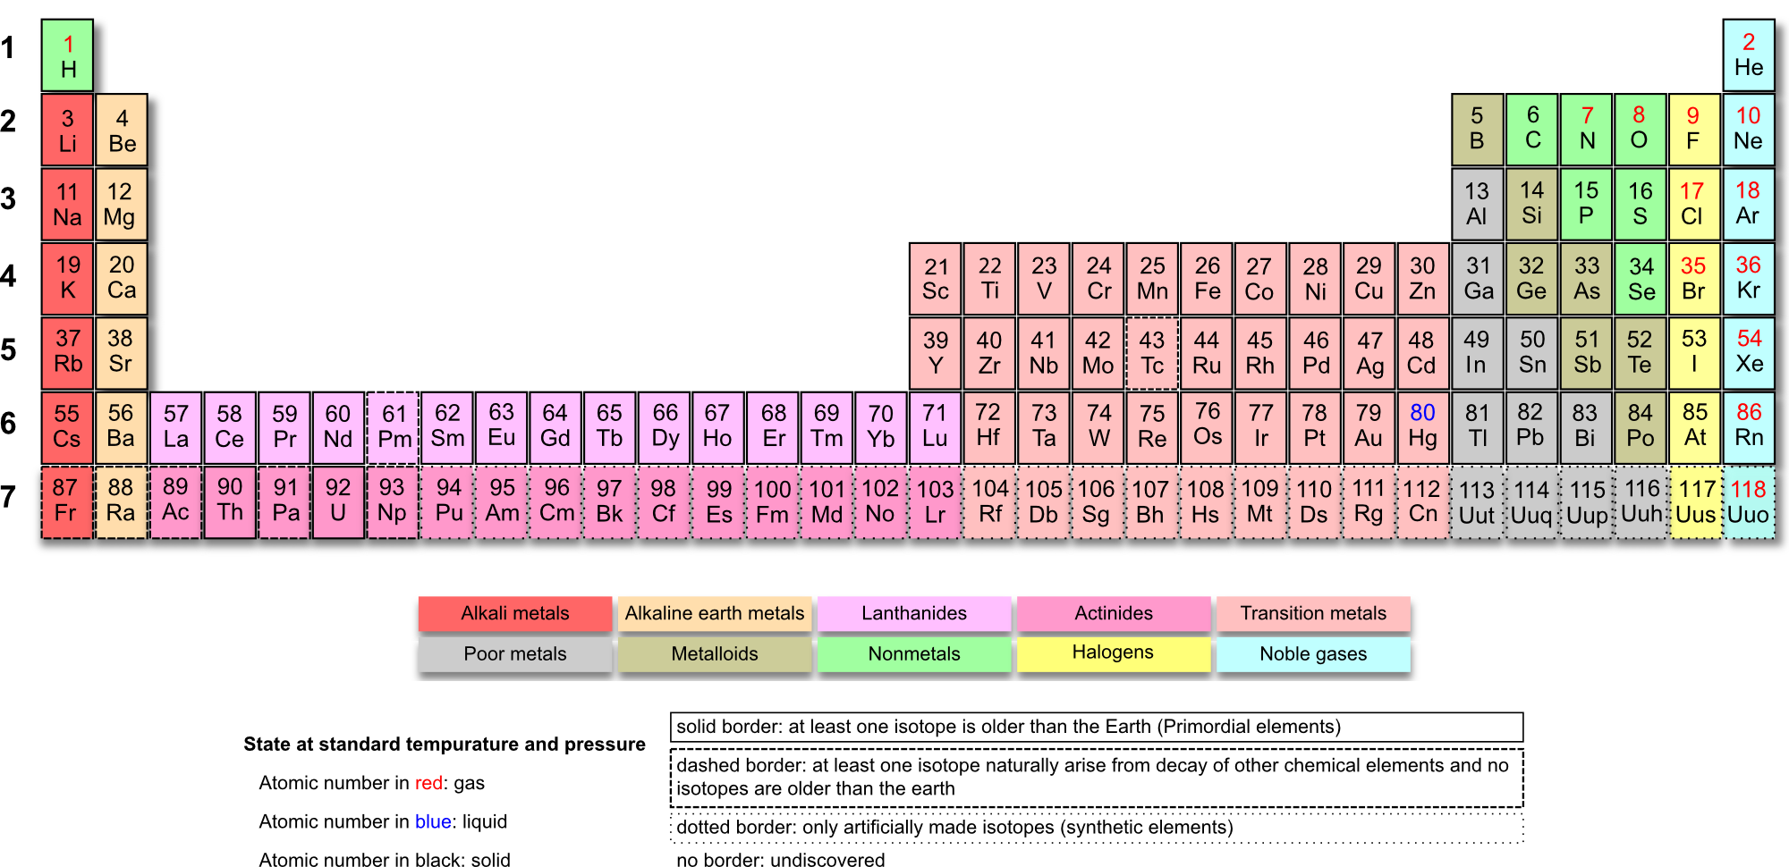

Slide 3
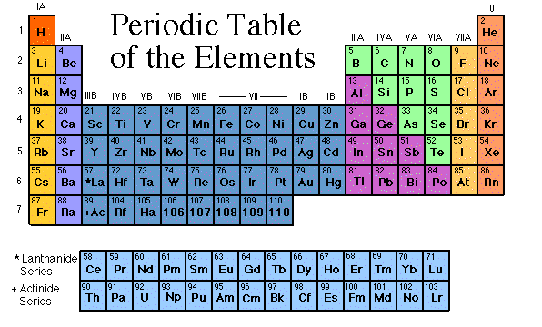

Slide 4
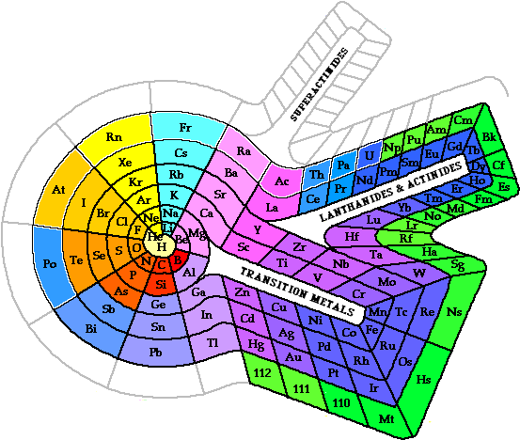
Another possibility: Spiral Periodic Table

Slide 5
The Father of the Periodic Table
Dimitri Mendeleev
Mendeleev
_______________was the first scientist to notice the relationship between the __________
  Arranged his periodic table by ________ _______
  Said properties of ___________elements could be predicted by the properties of elements around the missing element
_________later discovered that the periodic nature of the elements was associated with_________ _________, not atomic mass
elements
atomic mass
unknown
Moseley
atomic number
Notes:
5

Slide 6
What does the information in the box tell me?
1
H
1.008
Atomic Number = # of __________
protons
Atomic Mass = # of _________ + # of __________
protons
neutrons
Elemental
__________ Symbol
Notes:
6

Slide 7
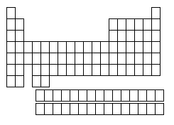
The Periodic Table
Column = Group or___________
_____ columns on the Periodic Table
Family
18
Row = __________
_____ rows on the
Periodic Table
Period
7

Slide 8
Metals, Nonmetals, and Metalloids
Nonmetals
______________ are on the right of the stair-step
Hydrogen
____________ is the only
nonmetal on the ___________ side
metal
Metals are on the _________ side of the stair- step
left
Semi-metals or
_____________
touch the stair-step
metalloids
Notes:
8

Slide 9
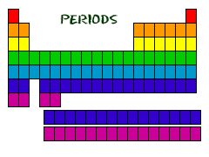
Periods = Rows
All of the elements in a period have the same number of atomic orbitals.
Every element in the top row (the first period) has one orbital for its electrons. All of the elements in the second row (the second period) have two orbitals for their electrons. It goes down the periodic table like that.

Slide 10
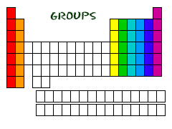
Groups = Columns
(called Families)
Elements in the same group have similar properties
The elements in a group have the same number of electrons in their outer orbital.
Every element in the first column (group one) has one electron in its outer shell. Every element on the second column (group two) has two electrons in the outer shell. As you keep counting the columns, you'll know how many electrons are in the outer shell.
Remember, there are always some exceptions

Slide 11
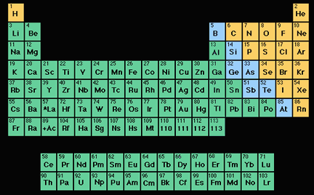
METALS
  Located to the left and below the zig-zag line in the periodic table.
Metals in this picture are all colored green

Slide 12
Properties of Metals
solids
Metals are usually __________at room temperature
Good conductors of heat and electricity
High melting points and boiling points (except Hg)
High densities (except some group 1 metals)
Metals have ______(are shiny) and reflect light
luster

Slide 13
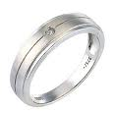


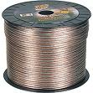
Properties of Metals
____________ - can be bent, pounded into sheets
Ductile – can be stretched into ________ without breaking
Malleable
wire

Slide 14
Properties of Nonmetals
Nonmetals are located to the __________ of the zig-zag or stair step line
right
Nonmetals in this image are in yellow

Slide 15
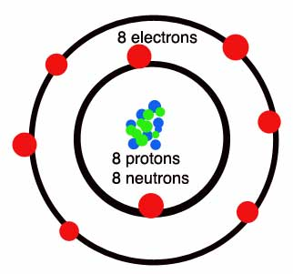
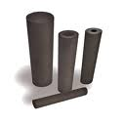
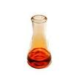
Properties of Nonmetals
The nonmetals exist in all three of the states of matter at room temperature: _________ (such as oxygen),_________(such as bromine), and ___________ (such as carbon).
gases
liquids
solids

Slide 16
Properties of Nonmetals
insulators
Nonmetals are _________ -not able to conduct electricity or heat very well.
Nonmetals have much lower melting and ________ points than metals.
Nonmetals are not nearly as dense as metals.
boiling

Slide 17
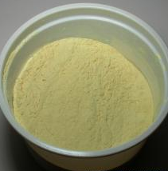
Properties of Nonmetals
luster
The nonmetals have no metallic ________, and do not reflect light.
Nonmetallic elements are very ________, and cannot be rolled into wires or pounded into sheets.
brittle
Sulfur powder

Slide 18
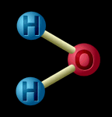
Hyrdrogen
OH, BOTHER!!
The Group 1 Nonmetal - the one element located on the “metal” side of the periodic table, that is not a metal.
Most of the hydrogen found in the world is found in water.

Slide 19
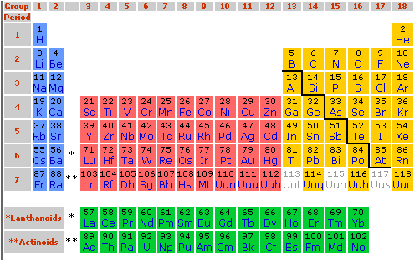
Properties of Metalloids
Metalloids are located _____ the staircase line, dividing metals from non metals.
Have a mixture of _________ and _____________ properties.
______________:
Can conduct heat and
electricity to some extent.
on
metallic
nonmetallic
Semi-conductors

