Slide 1
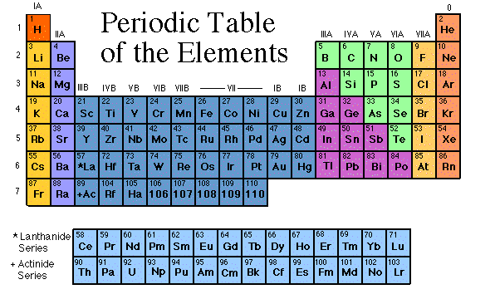
Periodic Table of Elements

Slide 2
chlorine
nitrogen
uranium
bromine
mercury
oxygen
hydrogen
helium
sodium
iridium
silicon
carbon

Slide 3
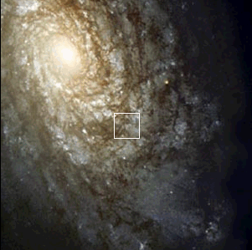
Elements
The elements, alone or in combinations, make up our bodies, our world, our sun, and in fact, the entire universe.

Slide 4
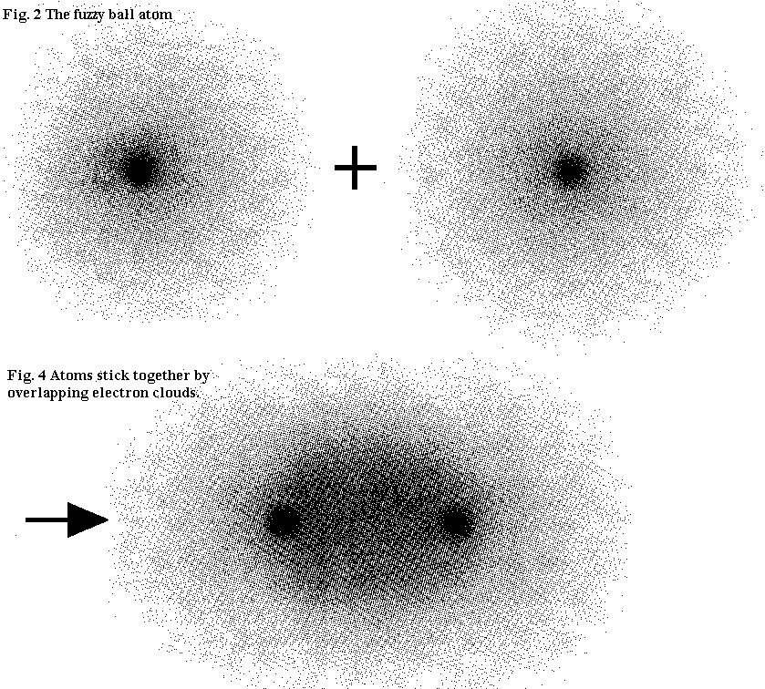
What does it mean to be reactive?
Elements that are reactive bond easily with other elements to make compounds.
valence electrons lose them during bonding. Atoms with 6, 7, or 8 valence electrons gain electrons during bonding.

Slide 5
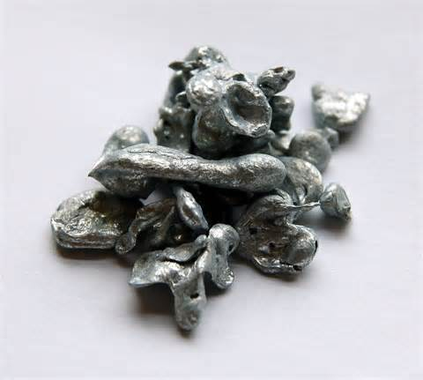
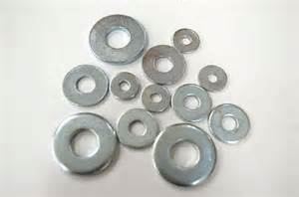
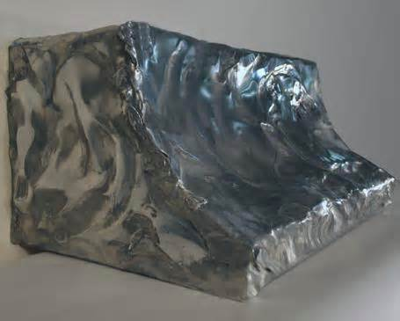
Can you identify this element?
30 Protons
Colorless: - Bluish silver
Solid
Transition Metal Family
A nutrient for humans
Used to make modern pennies and brass
Symbol: Zn

Slide 6
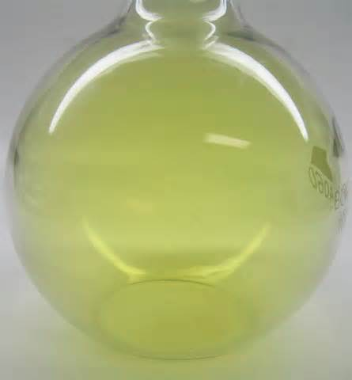
Can you identify this element?
17 protons
Color: Greenish yellow
Non metal
Gas
Deadly when breathed
Use to clean drinking water

Slide 7
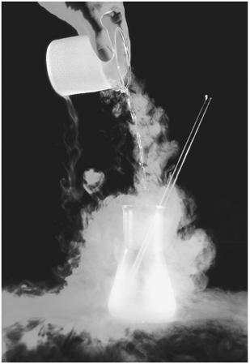
Can you identify this element?
7 Protons
Mostly a gas
Colorless
Used to make dynamite
Part of the air we breathe

