Slide 1
Our Expanding Universe:
Humanity’s changing vision of the cosmos
Presented by: EHS
Structure and Evolution of the Universe
Workshop
Location and Date here
Notes:
This presentation takes the audience through humanity’s changing view of the universe. It demonstrates how scientists use observations to create a model of the cosmos, and use that model to make predictions about how the cosmos behaves and changes. How does our current model of the universe hold up against the incredible new discoveries of recent years?

Slide 2
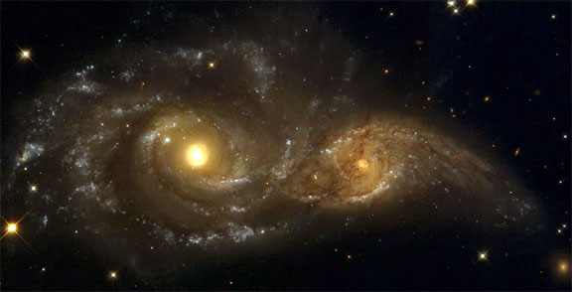
What is Cosmology?
The Study of the Universe: its structure, origin, evolution, and destiny
Our universal “world view”
Our cosmological model
Notes:
This Power Point was modified from a presentation created as part of the “Modeling the Universe” professional development workshop for classroom educators. The activities in the workshop use the nature of scientific models to explore various characteristics of the universe. Historically, there are three major models, or paradigms , in cosmology*. With the benefit of hindsight, the change from one model to another, a paradigm shift, is obvious. In reality, these watersheds in humanity’s vision of the cosmos were drawn out, contentious and unfocused. This powerpoint presents the sanitized version!
*Historically, there are of course many models of the universe, as each culture on every continent grappled with similar questions. The timeline to the Big Bang model has its origins in Greek/European science.

Slide 3
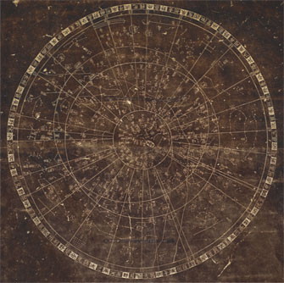
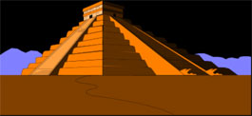
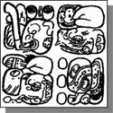
Cosmology through the ages…
Universe models formed in many cultures
Notes:
Long before telescopes and modern astronomy, cultures around the globe were keen observers of the sky, and created maps, metaphors, myths -- all mental models -- for how the heavens worked.
Top right: Mayan temple aligned with Sun; Middle: Stela glyphs that refer to “Cosmic Monster” that split to become earth and sky (Milky Way); Left: 11th Century Chinese map of stars in the sky, believed to indicate supernova of 1054; Bottom Right: Representation of Cosmos (Earth at the center -- starry cosmos all around) painted by Hildegard of Bingen, 11th Century nun

Slide 4
Our View of the Cosmos - the story of scientific models
Astronomy has seen 3 scientific revolutions in cosmology
2nd Century: Claudius Ptolemy (Physics of Aristotle)
Model: Earth-centered Cosmology
Big Idea: Different laws for Earth and the cosmos
16th Century: Nicolaus Copernicus (Physics of Newton) Model: Sun-centered Cosmology
Big Idea: Universal physics; same laws everywhere
20th Century: Edwin Hubble (Physics of Einstein)
Model: Big Bang Cosmology
Big Idea: Universe is changing, evolving
Notes:
Big Idea: summary of next few slides
These names represent pivotal figures in each model, and bring a human face to the endeavor, but they are by no means solely responsible. Ptolemy built on works of Hipparchus (160-127 BC), and Aristarchus (310-230 BC). The so-called Copernican revolution happened because of Johannes Kepler(1571-1630) and Galileo (1564-1642). Hubble’s discovery came alongside the work of V.M. Slipher (redshift), Heber Curtis (galaxies as “island universes”) and Harlow Shapley (distance measurements) to name but three.

Slide 5
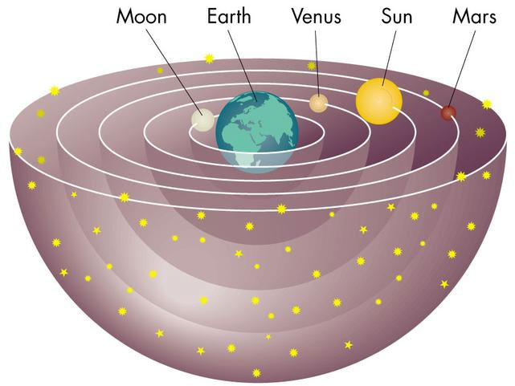
Earth-centered Cosmology: Claudius Ptolemy, 100-170 AD
…“the natural motion of the Earth ….is towards the center of the universe; that is the reason it is now lying at the center.” Aristotle, On the Heavens
Notes:
Big Idea: A geostatic model of the universe - centered around the Earth, and generally unchanging.
In this model the planets were considered to move within crystalline spheres. All spheres rotated once a day with the planetary spheres slipping slightly with respect to the outermost (starry) sphere, which accounts for their motions against the starry background. Comets were atmospheric effects caused by the friction of the innermost sphere against the upper atmosphere.

Slide 6
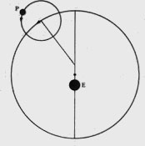
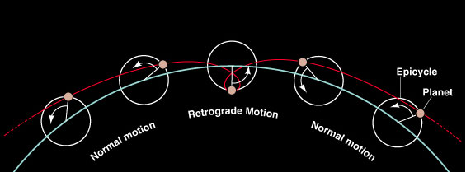
Testing the Earth-centered model
Prediction: Future planetary positions
Observation: retrograde motion of planets
Refine: epicycles
Success! For 1500 years
Notes:
Big Idea: the model must account for the observation. If the observation does not support the model, the model must be refined.
At a certain point in an outer planet’s (Mars, Jupiter, Saturn) orbit, the planet’s motion against the starry background reversed, or went retrograde. Easily explained in the Copernican model as the Earth overtaking the other planet on its inside orbit, it was unexplainable on the geocentric model. Ptolemy’s brilliant solution was the introduction of epicycles. Ptolemy’s geocentric model was the standard cosmology for 1500 years. Will the Big Bang model be as robust? Contrary to legend, the Ptolemaic model did not get more complex and unwieldy, but because it did not model planetary motion exactly, its predictions (in the form of published astronomical tables) became more and more inaccurate with time.

Slide 7
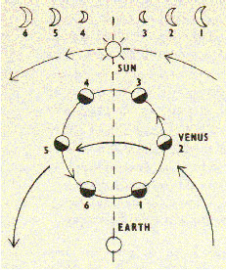
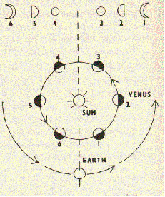
Testing the Earth-centered model
Prediction: Phases of Venus
Observation: Full set of phases
Crisis!
Notes:
Big Idea: If a model cannot be refined to account for an observation, there is a crisis in scientific understanding.
Galileo’s observations of the phases of Venus took place in 1615/16. Note that the observation proves the Ptolemaic model wrong, but does not prove the Copernican model right. The Danish astronomer Tycho Brahe (1546-1601) developed a geocentric model that would also allow Venus to show a full set of phases.

Slide 8
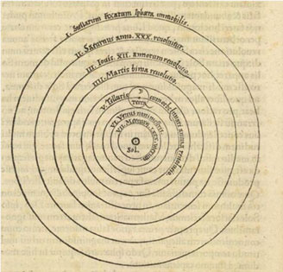
Sun-centered Cosmology: Nicolaus Copernicus 1473-1543
“At rest, however, in the middle of everything is the Sun.” Nicholaus Copernicus, de Revolutionibus
Notes:
Big Idea: Sometimes a new model is needed to explain observations.
The Copernican revolution was more of a gradual persuasion that an epiphany. At the time the model was presented (Copernicus was on his death bed as it was printing) there was no observational evidence favoring it over the geostatic cosmology.

Slide 9
Testing the Sun-centered model
Prediction: Future planetary positions
Observation: No better than Ptolemy
Refine: elliptical orbits (Johannes Kepler 1571-1630)
Notes:
Big Idea: evidence for the Sun-centered model
The elliptical orbits of the planets are so close to circles that you could not distinguish them by eye. They were elliptical enough however, to make planetary predictions by the Copernican model just as inaccurate as by Ptolemy.
Kepler discovered the elliptical nature of planetary orbits in 1602.

Slide 10
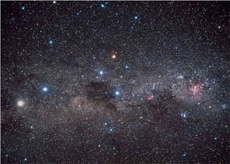
Testing the Sun-centered model
Prediction: Observed shift in position of stars (parallax) as the earth
Moves around the Sun.
Observation: No shift.
Crisis? No, but we had to wait until 1838 (Friedrich Bessel)
Notes:
Big Idea: parallax and the nature of science
Why so long? The closest star (alpha centauri the bright yellow star in the left of the photo) is over 200,000 times further away than the Sun. To measure its apparent shift against the background of further stars - the width of a finger a mile away - requires a sophisticated telescope. By the time Bessel’s observations were made, the cosmos of Newton and Copernicus was established without question. Astronomy then, as now, is a technology-driven science.

Slide 11
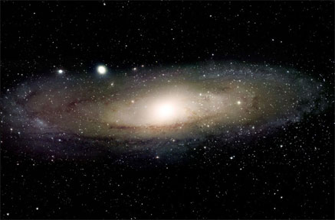
Testing the Sun-centered model
Prediction: Sun at center of Cosmos
Observation: Sun is not at center of universe (1918)
Observation: The galaxy is not the entire universe (1923)
Crisis!
Notes:
Big Idea: The universe of Einstein’s day
As late as the turn of the 20th century, astronomers believed that the Sun was effectively at the center of the galaxy, which was synonymous with the center of the universe. The work of Harlow Shapley and Henrietta Leavitt in 1918 displaced the Sun to the outer regions of the galaxy, and observations by Hubble and others proved that the Milky Way was just one galaxy of many (1923).
Note that these discoveries were made AFTER Einstein published his revolutionary work on gravity (in 1915). Einstein’s universe consisted of one galaxy, whose contents revolved around the Sun.

Slide 12
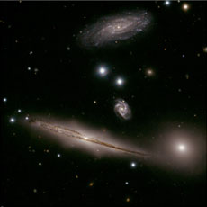
Big Bang Cosmology: Albert Einstein (1879-1955)
“A human being is part of a whole, called by us ‘universe’, a part limited in time and space.”
Notes:
Big Idea: the nature of science and Einstein’s ideas
Our modern model of the universe emerged before there was any observation to test it. Einstein’s theory of gravity (General relativity), published in 1915 predicted an expanding universe. The observations that showed the universe was expanding followed in 1929.

Slide 13
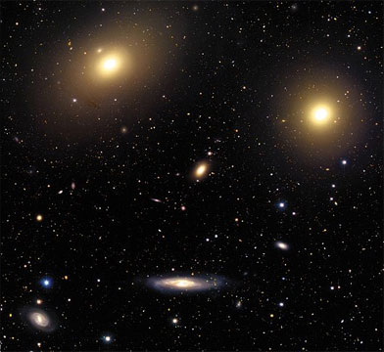
Testing the Big Bang model
Prediction: The universe is expanding
Observation: Galaxies are moving apart from each other (1929)
Notes:
Big Idea: evidence for an expanding universe
Further study of the motions of the galaxies by Hubble revealed that they were racing away from us and each other: proof of an expanding universe (1929).
Many people believe that the Big Bang is “just a theory” with no evidence to support it. In science, the word “theory” means an idea that is well-established and supported by scientific evidence. Hubble’s observations of galaxies moving apart from each other is one of SEVERAL lines of evidence that supports the Big Bang model.

Slide 14
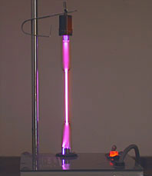
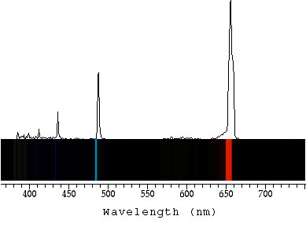
Evidence for an expanding universe
The spectrum of hydrogen gas is the unique
fingerprint of that element
Hydrogen lamp
Notes:
This slide and the next 6 show the observational evidence for the expanding universe model in the effect expansion has on the light we receive from distant galaxies.
Here we see the spectrum of a hydrogen gas lamp . Take special note of the way hydrogen atoms emit light at specific wavelengths.

Slide 15
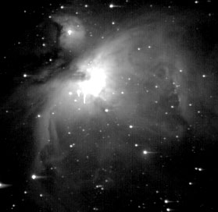
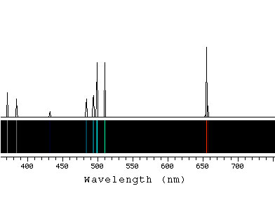
Evidence for an expanding universe
When we see a repeat of the pattern we saw in the lab, we know hydrogen is present
Orion Nebula
Notes:
The Orion Nebula is a star forming region in our own galaxy. It is made of mostly hydrogen, so the fingerprint lines of hydrogen (especially the strong red line at 656 nm) is present. The nebula also has a lot of oxygen, which accounts for the extra green lines in the spectrum.

Slide 16
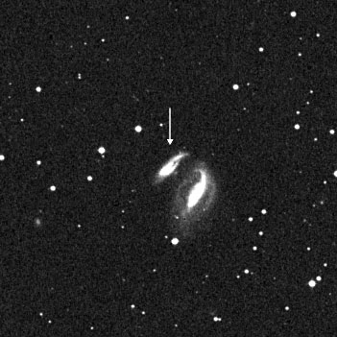
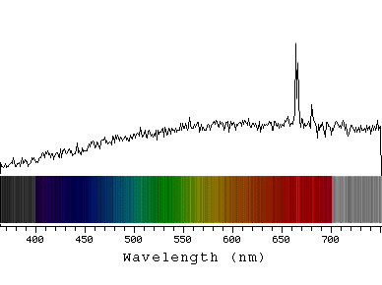
Evidence for an expanding universe
We see the same repeating pattern of lines in
a galaxy, but displaced to the red
Galaxy UGC 12915
Notes:
Here is the spectrum for the fairly distant galaxy pictured in the upper left. It has a lot of hydrogen that glows as an emission line in the spectrum too -- but pay close attention to the location of the 656 hydrogen line! The next few slides show galaxies at further and further distances (as evidenced by their decreasing apparent size in their Digital Sky Survey images) -- notice the “REDSHIFT” of their hydrogen line!
Galaxy: UGC 12915 Recession velocity: 4350 km/s Data courtesy Emilio Falco, CfA
[Note to speaker: H alpha line has been enhanced for illustrative purposes]

Slide 17
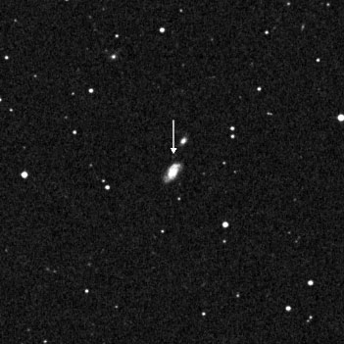
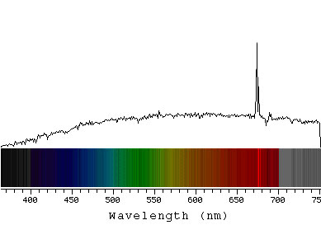
Evidence for an expanding universe
The further the galaxy,
the more the shift to the red
Galaxy UGC 12508
Notes:
Galaxy: UGC 12508 Recession velocity: 9100 km/s
Data courtesy Emilio Falco, CfA
[Note to speaker: H alpha line has been enhanced for illustrative purposes]

Slide 18
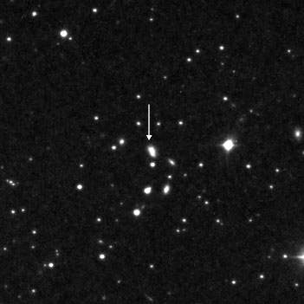
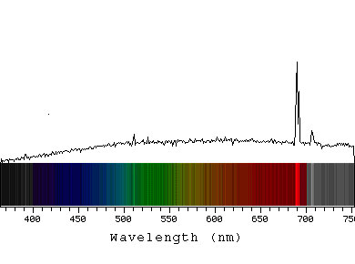
Evidence for an expanding universe
The greater the red shift,
the faster the galaxy is receding
Galaxy KUG 1750
Notes:
Galaxy: KUG 1750+683B Recession velocity: 15,400 km/s
Data courtesy Emilio Falco, CfA
[Note to speaker: H alpha line has been enhanced for illustrative purposes]

Slide 19
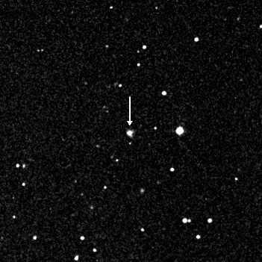
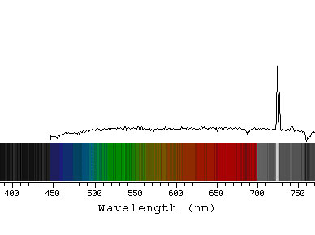
Evidence for an expanding universe
The red shift is caused
by the expansion of space.
Galaxy KUG 1217
Notes:
Galaxy: KUG 1217+324 Recession velocity: 31,400 km/s
Note the hydrogen 656 line is redshifted all the way into the infrared region of the spectrum.
Data courtesy Emilio Falco, CfA
[Note to speaker: H alpha line has been enhanced for illustrative purposes]

Slide 20
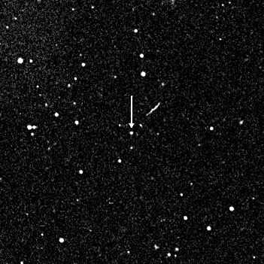
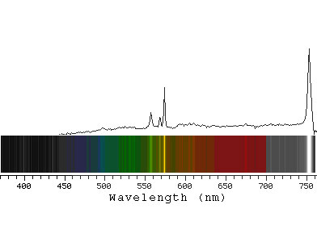
Evidence for an expanding universe
The red shift is evidence
for an expanding universe
Galaxy IRAS F09159
Notes:
Galaxy: IRAS F09159+2129 Recession velocity: 44,700 km/s
Data courtesy Emilio Falco, CfA
[Note to speaker: H alpha line has been enhanced for illustrative purposes]

Slide 21
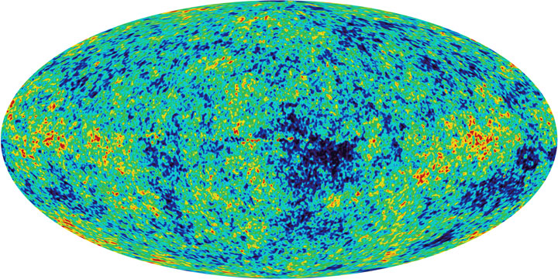
Testing the Big Bang model
Prediction: If the universe was denser, hotter, in past, we should see
evidence of left-over heat from early universe.
Observation: Left-over heat from the early universe. (Penzias and Wilson, 1965)
Notes:
Big Idea: evidence for the Big Bang model - leftover heat from the early universe
If you run the expansion of the universe backwards, there comes a time when the universe becomes very hot, dense and opaque - like living inside the Sun. The light from this time - 13.7 billion years ago, still bathes the cosmos. Originally at 3000K, it has now cooled to 3K, and can be detected by sophisticated radio telescopes such as WMAP (Wilkinson Microwave Anisotropy Probe).
Like Hubble’s observation of galaxies moving apart from each other, the discovery of this leftover heat is another line of evidence that supports the Big Bang model.

Slide 22
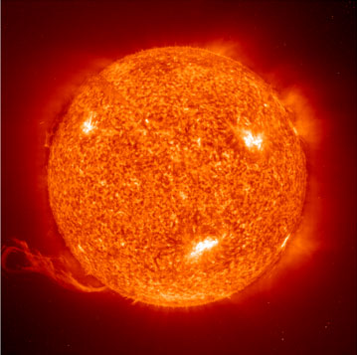
Testing the Big Bang model
Prediction: A hot, dense expanding universe, should be
predominantly hydrogen, helium.
Observation: Universe is ~75% hydrogen, ~25% helium by mass
The Sun: 74.5% H, 24% He by mass
Cecilia Payne
Notes:
Big Idea: evidence for the Big Bang model - composition of the universe.
The simplest of atoms, hydrogen, gets cooked into heavier elements at a high enough temperature and density (such as the cores of stars). In the early hot and expanding universe, this fusion process only has time to cook hydrogen to helium (plus a little lithium) before the expansion and cooling shuts down the nuclear furnace. All elements above helium in the periodic table are created in the life cycles of stars. The theory is 12:1 ratio hydrogen to helium by number, or 75% 25% by mass, from the Big Bang. Exactly what is observed. The chemical composition of stars (and the fact that they were predominantly hydrogen) was determined by Cecilia Payne (1925)
The composition of objects in the universe is one of several lines of evidence that supports the Big Bang model.
(Note: In 1925 Cecilia was the first person to receive a Ph.D. in astronomy from either Radcliffe or Harvard University, and the first person to receive a doctorate using work done at the Harvard Observatory. In 1934 she married Sergei Gaposchkin and hyphenated her name.)

Slide 23
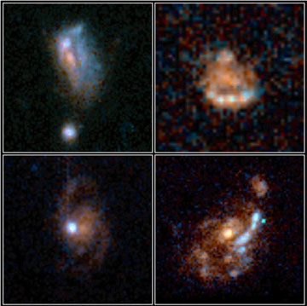
Testing the Big Bang model
Prediction: An expanding universe is evolving over time. If we look at the early universe, it should appear different.
Observation: Distant galaxies less evolved, physically and chemically.
Notes:
Big Idea: evidence for the Big Bang model - early galaxies look different.
Looking out in space is looking back in time. Distant galaxies therefore appear as they did in a less evolved universe. These early galaxies are more disturbed because of collisions with other galaxies, smaller and contain fewer heavy elements (“heavy element” is an astronomer’s expression for all elements other than hydrogen and helium).
Note to the presenter, if asked about the statement “looking out in space is looking back in time”: light takes time to travel through space. When light leaves an object it carries information about what the object looks like when the light left it. The further away an object it, the longer it takes to reach our eyes and telescopes. Therefore light that has been traveling from very far away carries information about what that objects looked like very long ago.

Slide 24
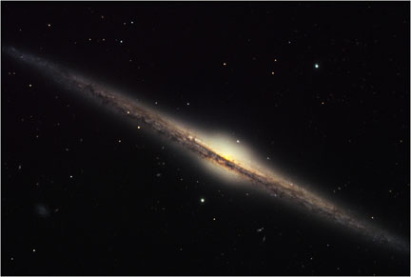
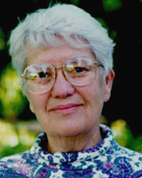
Testing the Big Bang model
Observation: 90% of matter is an unknown form: Dark Matter.
Refine: A new and unknown form of matter exists. But its gravity
works the same way, and its presence is needed to explain how
the universe looks.
Vera Rubin
Notes:
Big Idea: dark matter and how it fits into the Big Bang model
90% of matter in and between galaxies is of an unknown form that does not emit or absorb light. It can be detected through its gravity by the way it affects objects we can see. Dark matter was first detected between galaxies by Fritz Zwicky (1933) and in galaxies by Vera Rubin (1978). Without dark matter, normal matter would have been unable to clump and form stars and galaxies - and us.
If you wish to supplement this slide with a scientific animation, visit http://chandra.harvard.edu/resources/animations/galaxy_clusters.html and click on “Optical/X-ray Dissolve of MACSJ1423”
This animation shows views of the galaxy cluster MACSJ1423, using optical and X-ray telescopes. The optical image, a 3-color composite from the Subaru prime focus camera, shows white and blue galaxies centered around a large elliptical galaxy. The Chandra X-ray image shows hot gas displayed in red. The mass of the hot gas is about 6 times greater than the mass of all the billions of stars in all of the galaxies in the cluster. This galaxy cluster has a redshift of 0.54, at a distance corresponding to a light travel time of 5.4 billion years. [Run Time: 0:06] Credit: Optical: NAOJ/Subaru/H. Ebeling; X-ray: NASA/CXC/IoA/S.Allen et al.

Slide 25
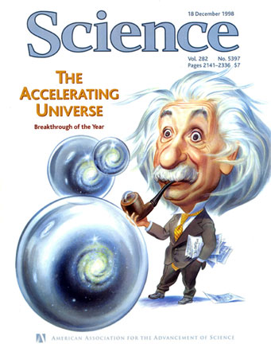
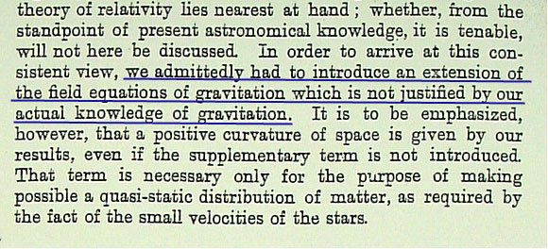
Testing the Big Bang model
Observation: Expansion is accelerating.
Refine: Extra energy content.
A recent discovery and of unknown
origin,the concept of Dark Energy is
actually an integral part of Einstein’s
theory of gravity.
Notes:
Big Idea: Dark Energy and how it fits into the Big Bang model
Supernovae in distant galaxies are further (so dimmer) than they should be, thanks to an accelerating universe.
70% of the energy content of the universe is contributed by “dark energy.” The energy of space, or vacuum energy, was a prediction of Einstein’s theory, and therefore an integral part of the Big Bang model. (26% is dark matter, 4% normal matter. When adding up the contents of the universe, we must add matter and energy together).
(Click for image on lower left) When Einstein first introduced this factor there was no observational evidence to support the idea. The next 5 slides explore the recently acquired evidence in more depth.

Slide 26
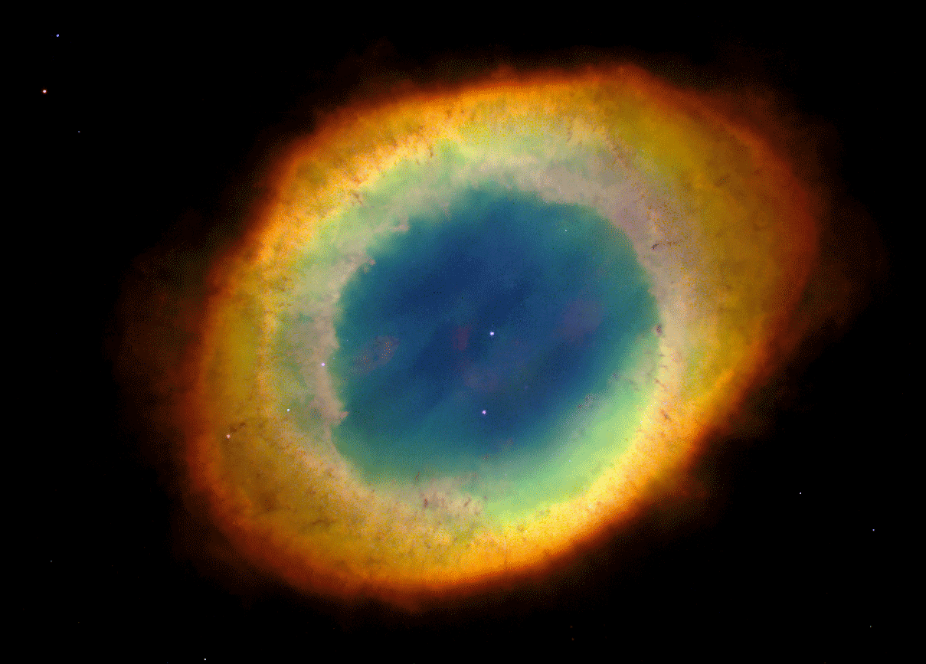
Evidence for Dark Energy - supernovae as distance indicators - step 1
A dying star becomes a white dwarf.
Notes:
Slide 1 of 5 about Type 1a supenovae. Big Idea: setting the stage for the supernova - creating a white dwarf.
There are different types of supernova, but the type we are interested in comes from a star like our Sun. When the Sun runs out of its nuclear fuel in about five billion years time, it will go through a beautiful death ritual, shedding its outer layers in a blaze of color while its inside squeezes down into a dense white hot ball about the size of the Earth. This ball, aptly named a white dwarf, is where the story ends for the Sun, but not so other white dwarfs. About 2/3 of all stars in a galaxy live in pairs (called binaries), a union that becomes dangerous when one of the pair turns into a white dwarf.
This image shows the Ring Nebula, Messier 57, with the white dwarf remnant at its core.

Slide 27
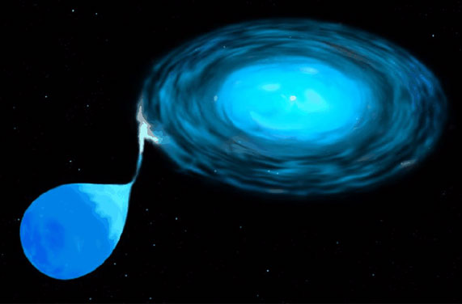
Evidence for Dark Energy - supernovae as distance indicators - step 2
The white dwarf strips gas from its stellar companion….
Notes:
Slide 2 of 5. Big Idea: setting the stage for the supernova - white dwarf binary
About 2/3 of all stars in a galaxy are binaries. One star may run through its life cycle faster, becoming a white dwarf while the other star continues to shine normally. This is true of the brightest star in the sky, Sirius, which has a faint white dwarf companion. The white dwarf is greedy, and if the orbit of the white dwarf and its companion is close, the white dwarf’s strong gravity begins to tug the outer layers of hydrogen gas from the companion and wrap the gas around itself, in the process creating a ticking time bomb.
This artists’ impression shows a star-white dwarf binary system. The two objects are close enough that the gravity of the white dwarf strips the outer hydrogen envelope off of its companion, spinning it into a flat disc because of white dwarf’s rapid rotation. The gas in the disc will eventually accumulate on the surface of the white dwarf creating a dense hot hydrogen atmosphere.

Slide 28
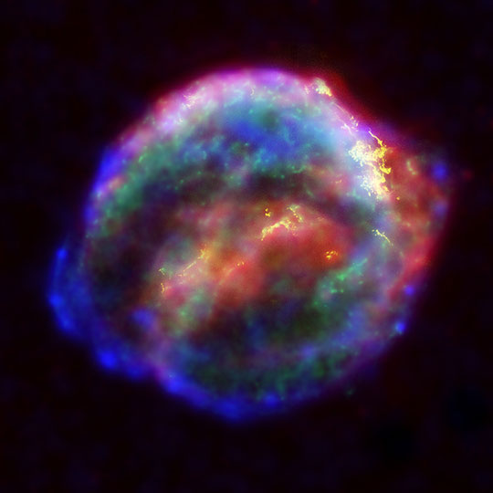
Evidence for Dark Energy - supernovae as distance indicators - step 3
….and uses it to become a hydrogen bomb. Bang!
Notes:
Slide 3 of 5. Big Idea: Supernova
The hydrogen layer grows, getting hotter and hotter, until at a critical temperature the bomb goes off – a thermonuclear explosion as bright as a billion stars, and a flash that can be seen across the observable universe. Because the process is identical for each white dwarf supernova, the event has a predictable, and reproducible, brightness.
A type Ia supernova was seen in our own galaxy by Johannes Kepler in 1604, five years before the invention of the telescope. This image is a composite of observations from three space telescopes, Hubble (yellow), Chandra (blue and green) and Spitzer (red) of the remnants of the star Kepler saw in the sky four centuries ago. The ball of debris is now about 8 light years across and still expanding.

Slide 29
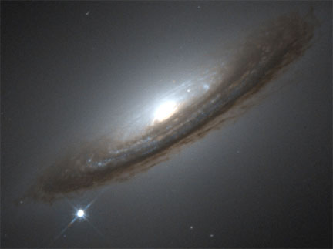
Evidence for Dark Energy - supernovae as distance indicators - step 4
The explosion is as bright as an entire galaxy of stars….
Notes:
Slide 4 of 5. Big Idea: Supernova
A supernova can shine as bright as a billion stars for several days, rivaling an entire galaxy of stars. This image shows a type Ia supernova explosion in the galaxy NGC 4526. Because the explosion is just a point of light in the sky looks like a star. The processes and conditions that create this type of explosion are effectively identical for each white dwarf supernova, so the event has a predictable, and reproducible, brightness. This makes them ideal distance indicators - the fainter they are the further they are.
By measuring the brightness of the supernova flash in NGC 4526, the distance to the host galaxy can be calculated. Note to the presenter: a discussion of how this distance is determined (I.e. how we know it is “further away than it should be”) is not required, but if asked, you can use the comparison of a flashlight. This type of supernova has a known brightness (like a flashlight with a certain watt bulb) and can only be that bright. Just as a flashlight shining from further away appears dimmer than one nearby, measuring the light from this type of supernova tells scientists how far away it is.

Slide 30
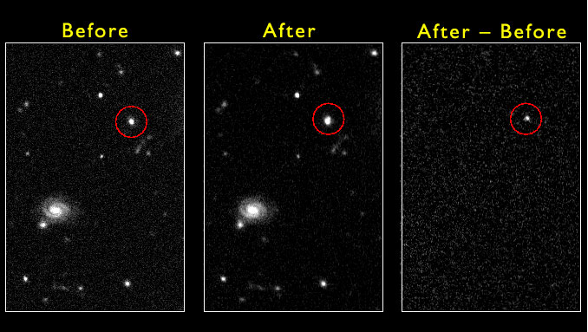
Evidence for Dark Energy - supernovae as distance indicators - step 5
…..and can be seen in galaxies across the universe.
Notes:
Slide 5 of 5. Big Idea: How scientists detect the supernovae
By carefully subtracting the two images using powerful computer software, supernovae can be found in distant galaxies. The light from one of these distant galaxies has increased since the first image was taken. What is left after the subtraction is the light from a Type 1a supernova. The brightness of the supernova gives an accurate measure of the distance to its galaxy.
The distance of the galaxy can also be found from the redshift (see slides 14 to 20) The distance by redshift is based on how fast the universe is expanding. The distance by supernova is and actual physical distance based on the inverse square law of light. Analysis reveals that this galaxy is further away than it should be for its redshift.
With a large collection of supernova observations at different distances, a history of the expansion of our universe can be constructed. It shows that, for the first eight billion years, the expansion rate was slowing. Then, around five billion years ago, the expansion started to speed up. This is the strongest piece of observational evidence for Dark Energy.

Slide 31
“Normal Matter”
4%
Dark Energy
73%
Dark Matter
23%
Notes:
Big Idea: Composition of the universe
Astronomers are able to determine how much dark energy there is based on the measured rate of expansion of the universe. They are able to do this because Einstein's theory of gravity relates the expansion rate of the universe to the total amount of all forms of mass or energy in the universe.
The result is that about 73% of the content of the observable universe must be dark energy. In other words, most of the universe is made of some mysterious form of energy whose nature is completely unknown.

Slide 32
Conclusions
Big Bang model describes our current understanding of the universe.
New discoveries, such as dark matter and accelerating
expansion (Dark Energy), lead us to refine our model,
but there is no crisis in our understanding (yet).
Science is an ongoing process - forcing us to test
our model through prediction and observation. The
more tests it passes, the greater is our confidence in it.
Notes:
The Big Bang model, our current understanding of the universe, is a strong, well-supported model. It takes into account all observed evidence and no evidence has yet been found that contradicts it. Although it is the most complete model we have to explain how the universe works, there are still questions that remain for scientists and for humanity.

Slide 33
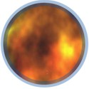
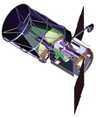
The Future of Cosmology: Beyond Einstein
What powered the Big Bang?
What is Dark Energy?
How did the Universe begin?
Notes:
Our model provides a very detailed picture of how the universe behaved just moments after the Big Bang, but absolutely nothing about the moments before it. It accurately describes the expansion of the universe and its changing nature, but cannot predict its fate. NASA’s newest space missions, including the Constellation-X Observatory, the Laser Interferometer Space Antenna (LISA), and the smaller Einstein Probes (designed to study inflation, black holes, and dark energy) are scheduled to launch in the next decade and will push technology to its limit, offering new evidence to further develop our model of the universe. Along with the James Webb Space Telescope (formerly the Next Generation Space Telescope, not pictured), the observations from these exciting missions will continue Einstein’s legacy of expanding our view of space and time.

Slide 34
Credits
Colliding galaxies: NASA & the Hubble Heritage Team (STScI)
Phases of Venus: Albert Van Helden
Star field: NASA/GSFC
Andromeda: Palomar Observatory, P. Challis, CfA
HGC 87: Gemini Observatory/GMOS-S
Galaxy cluster: Jean-Charles Cuillandre (CFHT), Hawaiian Starlight, CFHT
Orion nebula: MicroObservatory, SAO
Galaxy data: courtesy Emilio Falco, CfA
Comic microwave background: NASA/WMAP
Sun: SOHO/NASA/ESA
Cecilia Payne: President and Fellows of Harvard College
Early galaxies: NASA, Richard Griffiths/JHU, Medium Deep Survey Team
Edge-on galaxy: Bruce Hugo and Leslie Gaul, Adam Block (KPNO Visitor Program), NOAO, AURA, NSF
Ring nebula: H. Bond et al., Hubble Heritage Team (STScI / AURA), NASA
White dwarf accretion: STScI, NASA
Supernova Remnant: NASA/ESA/JHU/R.Sankrit & W.Blair
Galaxy and supernova data: High-Z Supernova Search Team, HST, NASA
Composition of the universe: SAO
Spacecraft and Einstein probes: NASA
ALBERT EINSTEIN and related rights ™/© of The Hebrew University of Jerusalem, used under license. Represented by the Roger Richman Agency, Inc., www.albert-einstein.net
Please contact einstein2005@cfa.harvard.edu for more information about non-credited historical images.
http://www.universeforum.org/einstein/
URL or program name here

Slide 35
Additional Credits
This presentation was initially developed for the “Modeling the Universe” educator workshop by the Universe Education Forum and our NASA mission partners.
For additional information and activities related to the themes of this presentation, please visit the “Modeling the Universe” web site:
http://www.universeforum.org/mtu/
This collaboration is part of the education and public outreach program from NASA’s Science Mission Directorate.
http://www.universeforum.org/einstein/
URL or program name here

