Slide 1
I can tell the difference between fact, theory, hypothesis, and law
Associate vocabulary related to relative size with pictures
Collaborate with a partner to create a graphic organizer
Find a partner
Explore Scale of the Universe program
Create a scale with large objects

Slide 2
Find a partner
Cruise to the library
Explore Scale of the Universe program
Grab a piece of paper from Mr. D
Create a scale representing 10 large objects in our universe
Label each object with a name and measurement

Slide 3
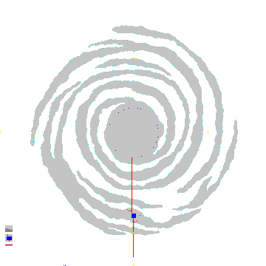
Whirlpool Galaxy
1.8 x 10^{21 meters}
Diagram and label 10 objects

