Slide 1
THE FERMI PARADOX
Where are the little green men?
Are “they” out there?

Slide 2
Fermi’s Paradox
Back in the 1940’s, a group of scientists were discussing extraterrestrial life.
Fermi asked “So? Where is everybody?”
What did he mean?

Slide 3
Fermi’s Paradox
Meaning: If there are billions of planets capable of supporting life….
The law of large numbers indicates that extraterrestrial life should not be rare.
Why haven’t any visited Earth?

Slide 4
Fermi’s Paradox
He realized that any civilization with modest rocket power and some initiative could colonize the galaxy within a few million years

Slide 5
Fermi’s Paradox
Aliens have had more than enough time to colonize the galaxy
So, where were they?
Question: If OUR civilization is so advanced, where are the other advanced life forms?

Slide 6
Solutions to Fermi’s Paradox
I. They exist but have not yet communicated
They have not had time to reach us
Still only travel speed of light
Problem: civilizations forming before us
They ARE signaling, but we don’t know how to listen
Exotic signaling methods we don’t know about
Problem: If they are so advanced, they should also use “primitive” methods to communicate with us

Slide 7
Exist but not communicate (cont.)
No desire to communicate
Advanced civ. doesn’t want to communicate with “lesser” beings
Problem: Curiosity
Berserkers
Killer robots searching the galaxy, so aliens are keeping it on the D.L.
Problem: Why haven’t berserkers come after us yet?

Slide 8
We are looking in the wrong place.
The “Singularity” hypothesis:
computers improve at exponential rate
next phase of evolution might be conversion from biological to software-based “life”
artificial intelligence and/or uploaded biological intelligence
silicon-based life would not appreciate terrestrial conditions
oxygen and water nasty stuff if you’re a computer

Slide 9
Solutions to Fermi’s Paradox
II. They do not exist
We are the first life forms, evolution takes time
Problem: Sun is average, and young. This view very “American”
Life is rare
Life’s Genesis is rare
Intelligence / tool making rare
Technology / Science is not an inevitable outcome

Slide 10
They do not exist (cont.)
Planets with right conditions are rare
Space is a dangerous place
Habitable zones
Moon stabilizes the earth’s orbit.
A magnetic field which protects us from radiation.
We have abundant liquid water.
Jupiter “broom” protects us from impacts.

Slide 11
They do not exist (cont.)
Catastrophes
Civilizations only have a limited lifetime. They are all dead.
Overpopulation
War
It is the nature of intelligent life to destroy itself.
It is the nature of intelligent life to destroy others.

Slide 12
Solutions to Fermi’s Paradox
III. They are here!
They were here and left evidence
UFO’s, Ancient Astronauts, Alien Artifacts.
Problem: No evidence. (Stonehenge not withstanding)
They are us!
Humans are descendants of aliens
We are the result of their “contamination” (Panspermia).
Problem: Where are the original aliens?

Slide 13
I. They are here! (Cont.)
Zoo scenario
Aliens are keeping us in a well designed zoo, cut off from contact.
The aliens are cloaked.
They visit to study us w/o interference.
They visit to experiment (alien abductions wars, pandemics etc.).
We are for their amusement (pets).
Problem: Can’t test this hypothesis. Only one alien showing his face would break the illusion

Slide 14
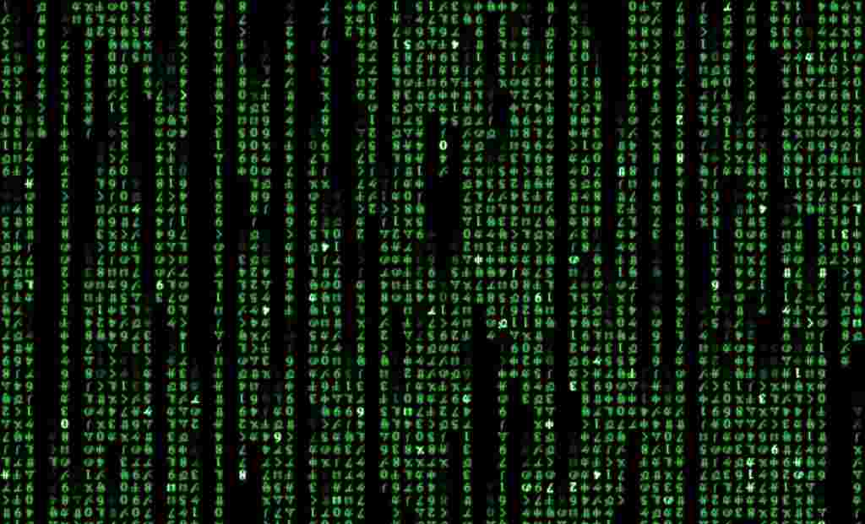
We do not exist.
If humanity is destined to develop into a post-biological computer-based culture
they might well wish to study their ancestors
they might choose to do this through computer simulation
with near-unlimited computing power, their simulated personalities would be conscious
There is only one real past, and presumably many simulations, so...

Slide 15
Fermi’s Paradox Solutions
Basically comes down to 2 possibilites:
1. Life is difficult to start or evolve
2. Advanced civilizations destroy themselves before colonizing space

Slide 16
We are looking for them!
Searching is limited by great distances.
We look for direct planetary observations (exoplanet hunters).
We look for alien constructs (probes, colonies, or artifacts (Dyson spheres).
What have we found?
NOTHING !

Slide 17
We have signaled them.
Pioneer 10 was launched on 2 March 1972.
Pioneer 11 was launched on 5 April 1973.
First man made objects to leave the solar system
Pioneer plaque.

Slide 18
The Golden Record
Voyager I launched on September 5, 1977.
Voyager II launched on August 20, 1977.
Explains the origin of the spacecraft.
115 images and a variety of natural sounds.
spoken greetings in many languages.

Slide 19
We are sending radio signals (Arecibo message )
Beamed into space in 1974.
Aimed at the globular star cluster M13 some 25,000 LY away.
1679 binary digits.

Slide 20
We are leaking signals to space.
TV shows from the 50’s are now 5,860,000,000,000 mi. “out there”.
WHAT WILL THEY THINK OF US?

Slide 21
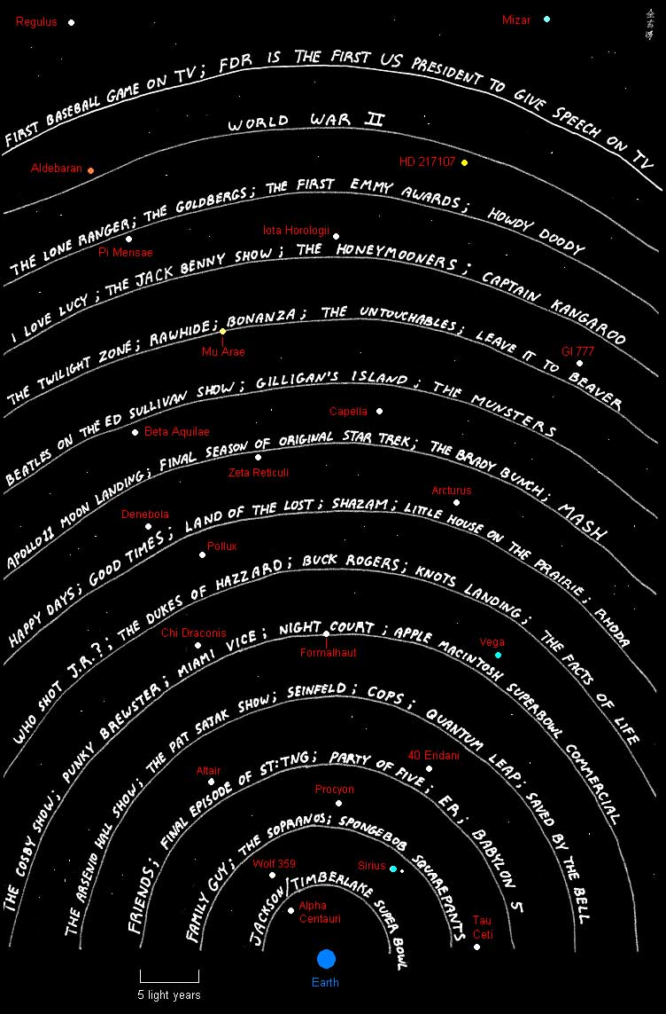

Slide 22
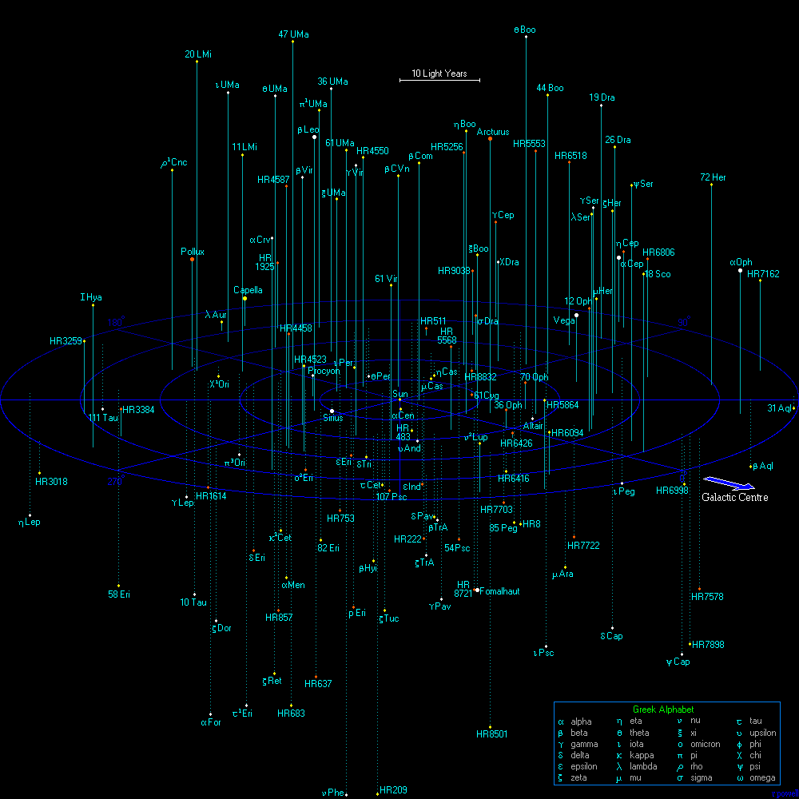
Stars within
50 light years

Slide 23
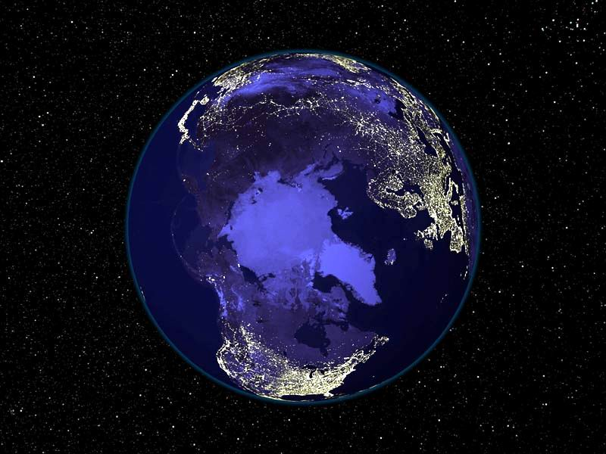
Can They See Our Lights?

Slide 24
WHAT DO YOU THINK?
PBS Nova Poll results:
16% think that we are alone in the universe.
77% think that there is other intelligent life somewhere in the universe.
7% undecided.

