Slide 1
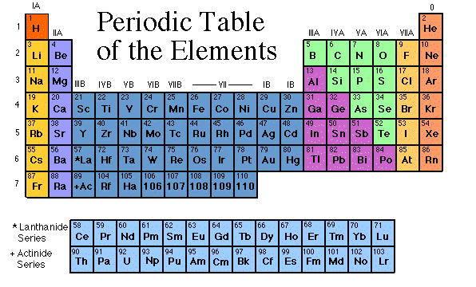
Periodic Table of Elements

Slide 2
chlorine
nitrogen
uranium
bromine
mercury
oxygen
hydrogen
helium
sodium
iridium
silicon
carbon

Slide 3
Elements
The elements, alone or in combinations, make up our bodies, our world, our sun, and in fact, the entire universe.

Slide 4
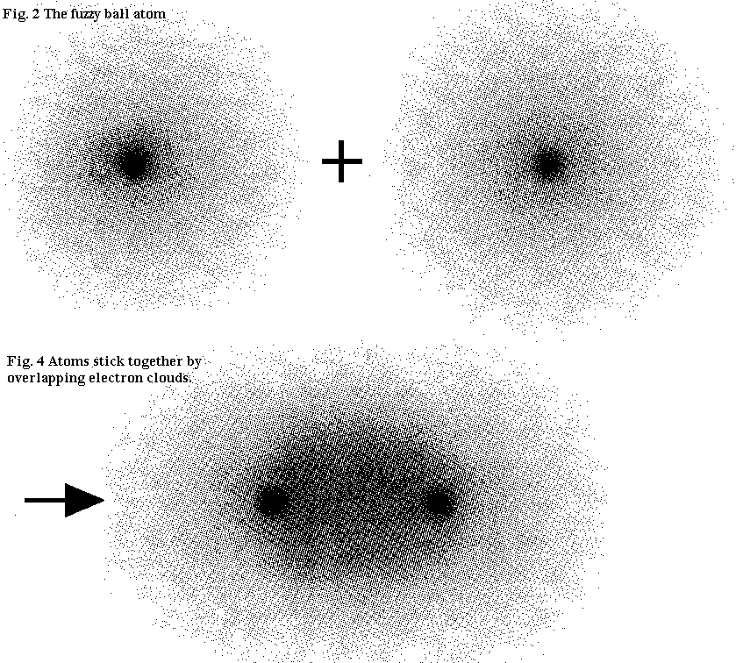
What does it mean to be reactive?
Elements that are reactive bond easily with other elements to make compounds.
Some elements are only found in nature bonded with other elements.
What makes an element reactive?
All atoms (except hydrogen) want to have 8 electrons in their very outermost shell or cloud (This is called the rule of octet.)
Atoms bond until this level is complete.
valence electrons lose them during bonding. Atoms with 6, 7, or 8 valence electrons gain electrons during bonding.

Slide 5
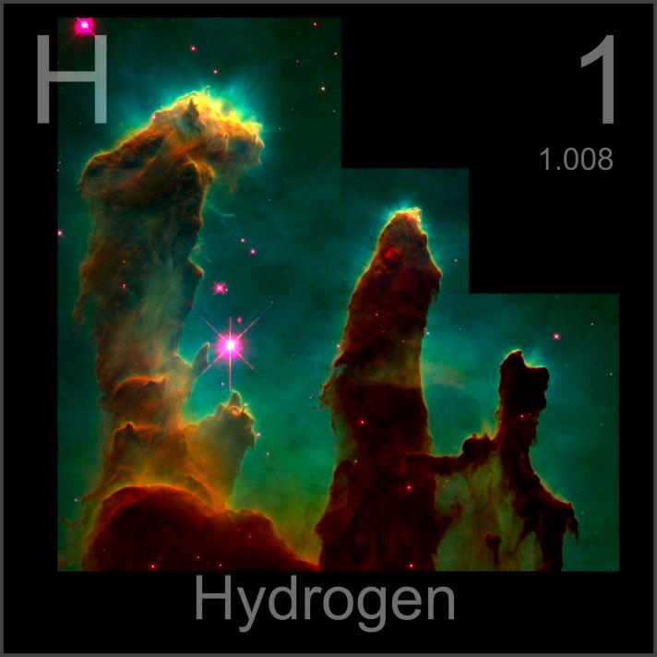
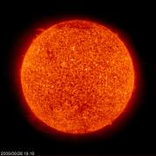
Can you identify this element?
1 proton
Colorless: - can’t be seen
Gas: - found in gas state, not liquid, or solid
Lightest gas: - least density, lighter then air
Formed in Big Bang
Main fuel for nuclear fusion
Most abundant element in Universe

Slide 6
Can you identify this element?
Colorless: - can’t be seen
Gas: - found in gas state, not liquid, or solid
2nd lightest gas: -lighter than air
Reactivity: not much. Mostly inert and sits there
Formed in Big Bang and also in stars undergoing fusion

Slide 7
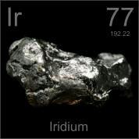
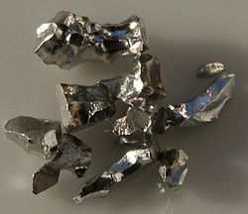
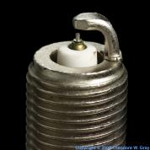
Iridium
77 protons
silvery-white metal transition metal
Iridium is one of the rarest elements in the Earth's crust
Hard and brittle
Iridium layer on Earth was major evidence for dinosaur extinction

Slide 8
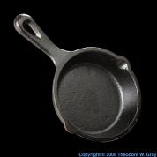
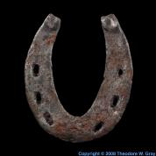
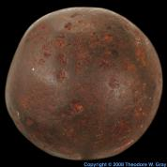
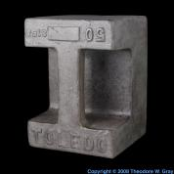
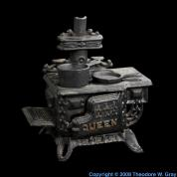
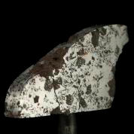
Can you identify this element?
26 Protons
Most widely used of all metals as base metal in steel
Formed in fusion by stars
Element responsible for the death of stars
Tough, malleable, ductile and easily welded

Slide 9
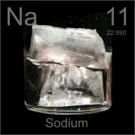
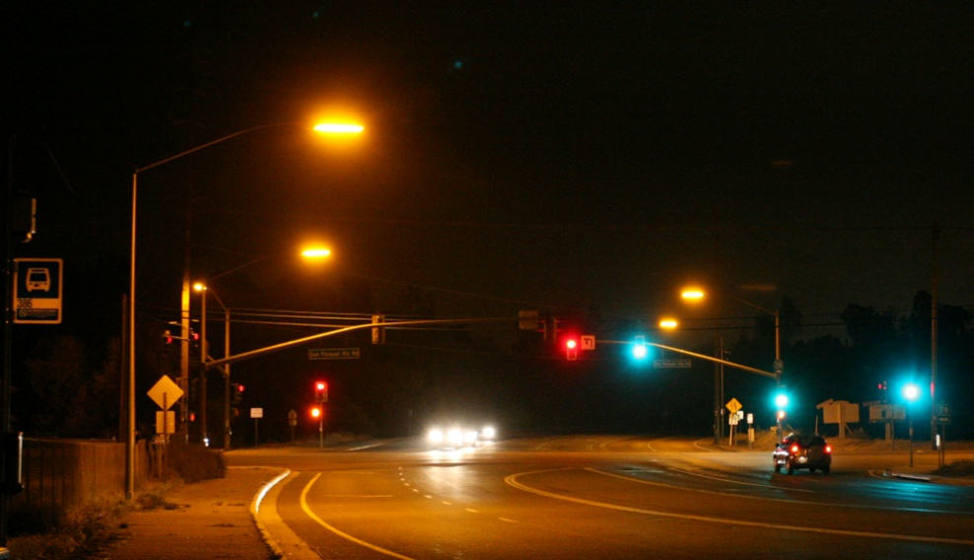
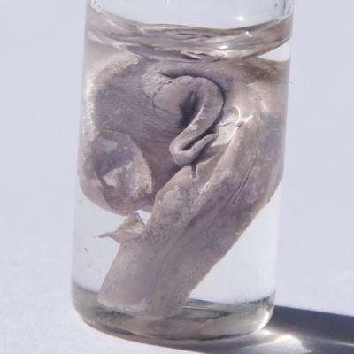
Sodium
11 protons
Color: Silvery white
A soft metal that reacts in seconds of being exposed to the air
Reacts vigorously with water.
Most common compound is sodium chloride.
Used in de-icing roads

Slide 10
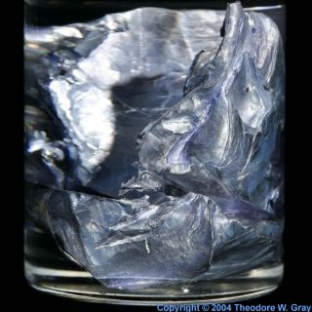
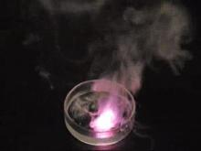
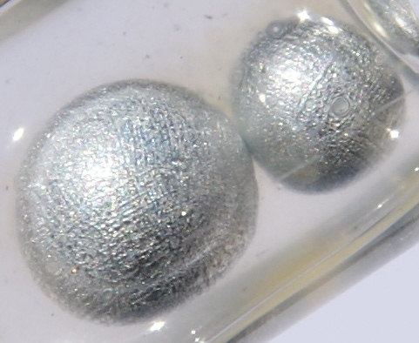
Can you identify this element?
26 Protons
Color: silvery white
Very reactive element and is never found free in nature.
Soft, waxy metal that can be easily cut with a knife
Reacts in seconds of being exposed to the air and water.
Formed in supernova explosions

Slide 11
http://www.teachengineering.org/view_activity.php?url=collection/cub_/activities/cub_mix/cub_mix_lesson2_activity1.xml

Slide 12
Properties of Metals
Metals are good conductors of heat and electricity.
Metals are shiny.
Metals are ductile (can be stretched into thin wires).
Metals are malleable (can be pounded into thin sheets).
A chemical property of metal is its reaction with water which results in corrosion.

Slide 13
Properties of Non-Metals
Non-metals are poor conductors of heat and electricity.
Non-metals are not ductile or malleable.
Solid non-metals are brittle and break easily.
They are dull.
Many non-metals are gases.
Sulfur

Slide 14
Properties of Metalloids
Metalloids (metal-like) have properties of both metals and non-metals.
They are solids that can be shiny or dull.
They conduct heat and electricity better than non-metals but not as well as metals.
They are ductile and malleable.
Silicon

Slide 15
The most abundant element in the earth’s crust is oxygen.

